Slide 1
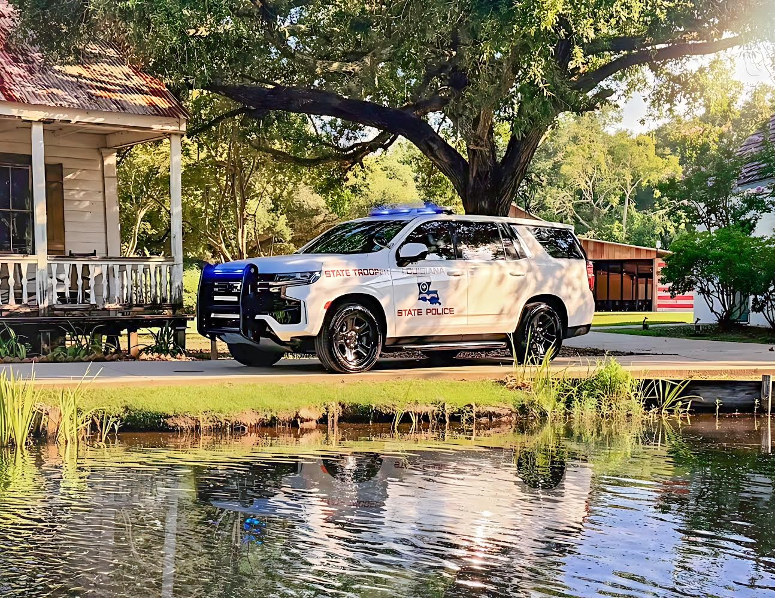

Slide 2


LMTA 2026 Transportation Conference
Captain Bert Dabadie, Commander

Slide 3
Mission/Goal Statement
LSP TSS is responsible for the enforcement of all applicable Federal and State regulations that relate to the commercial motor transportation industry. The primary mission of TSS is maintaining the safety of those traveling our roadways through education, uniform enforcement of applicable regulations and partnerships with industry and our State and Federal counterparts. Our section will continue to work with Louisiana carriers to ensure your businesses thrive, while maintaining an appropriate level of safety.

Slide 4
Goals for 2026 / Plan for Success
Reduction in CMV fatal and injury crashes
Continue our Human Trafficking and Traffic Enforcement Initiatives
  Reduction in personal vehicles operating dangerously around your CMVs (enforcement focusing on non-commercial vehicles, i.e. “small cars brake-checking CMVs”)
Increased educational initiatives through safety talks, informational videos, and correspondence with industry officials (EDUCATION with ENFORCEMENT)
Ensuring an open line of communication with regional supervisors/offices
  Region 1 (Troops A, B, L)
  Region 2 (Troops C, D, I)
  Region 3 (Troops E, F, G)
If you have a question, call/email us!

Slide 5
Industry Outreach
Carrier presentations on federal and state regulations
Social media outreach on regulations pertaining to federal/state laws pertaining to CMVs
Correspondence with industry stakeholders on compliance related regulations
Refresher training with TSS commissioned personnel on proper enforcement/discretion of violations

Slide 6
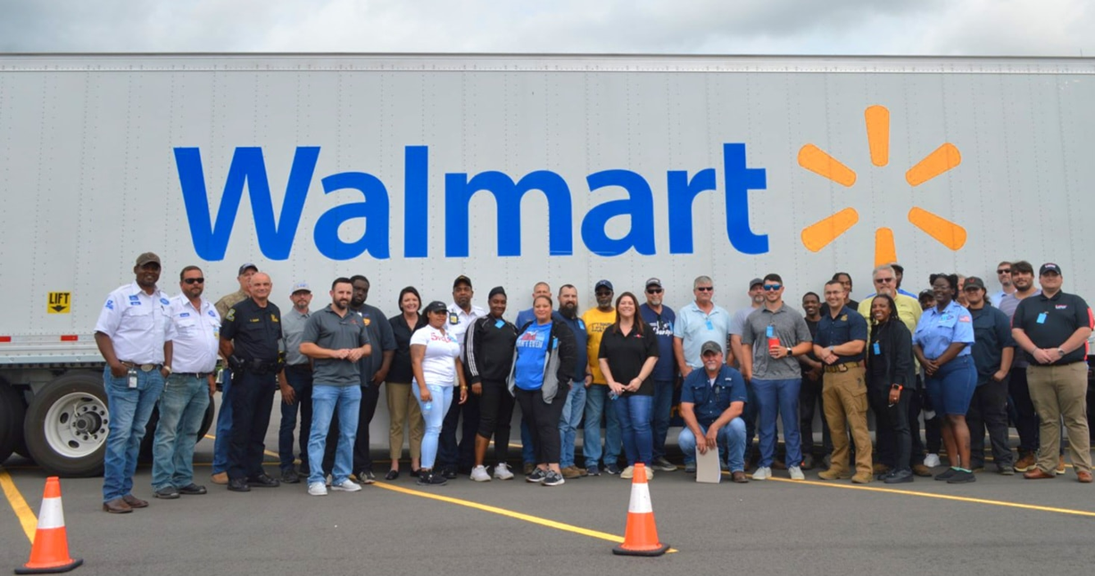
Industry Outreach

Slide 7
Truckers Against Trafficking
LSP has partnered with Truckers Against Trafficking (TAT)
We have included TAT educational material as part of our safety talks and posted educational pamphlets at stationary scales throughout the state. We have also added the TAT contact information to our SafeSpect inspection report and online payment instruction document. These documents are given to every driver after each inspection.

Slide 8
Human Trafficking Initiative
LSP was awarded a FMCSA high priority grant, for the detection and prevention of human trafficking in commercial motor vehicles.
LSP trained with our investigative personnel and other state partners in identifying human trafficking in CMVs
This High Priority Grant expired in 2025, however LSP will still remain focused on recognizing various forms of human trafficking while conducting roadside inspections

Slide 9
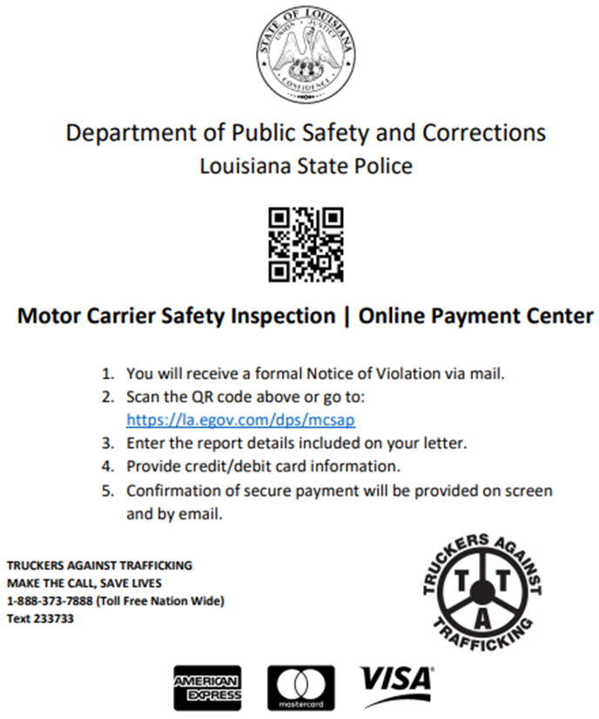
Truckers Against Trafficking
This form is issued to CMV drivers on all inspections and eventually reach carrier officials, increasing TAT exposure to those in the commercial trucking industry.

Slide 10
Most Common Roadside Violations!
Weight violations (ensure you know the difference in interstate versus non-interstate weight limits)
  If you need a permit, BUY A PERMIT
  Choose non-interstate routes for heavier loads
  Find and avoid bridges with posted weight limits
  Ensure your drivers are remembering to lower the tag (lift) axles
  Ensure you aren’t being overloaded at fill sites
FMCSA violations
  Proof of inspection
  Parking without emergency flashers/triangles, no parking zone (typically on interstate)
  Brakes out of adjustment
  Weight Violations
  Seatbelt
  Failing to certify ELD/logbook
  Mud flaps
  False record of duty status
Notes:
CP can help with inspection since the department has had issues of filling spots. Have a Human Traffic Case ongoing.

Slide 11
Traffic Enforcement Initiative
LSP has applied for and was awarded a FMCSA high priority grant, for increased traffic enforcement in commercial motor vehicles on US Highways, State Highways, and the Interstate Systems.
This will include CMVs less than 26,001 GVWR (single unit box truck) operating in intrastate commerce as well as passenger vehicles operating aggressively near CMVs

Slide 12
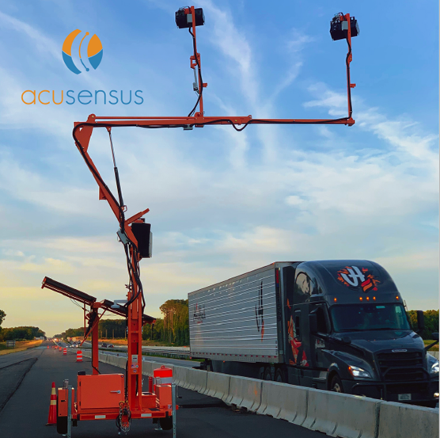

Slide 13
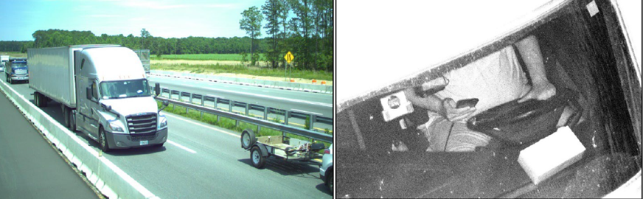

Slide 14
English Language Proficiency (ELP) Regulation
Following President Trump’s Executive Order on truck driver regulations, the Commercial Vehicle Safety Alliance (CVSA) decided to again include non-compliance with the English language requirement (CFR 391.11(b)(2)) in its North American Out-of-Service Criteria, starting June 25. This means drivers who cannot read or speak English well enough to communicate or understand road signs may be taken out of service.

Slide 15
English Language Proficiency (ELP) Regulation
CVSA has added the following language to the out-of-service criteria:
“Driver cannot read and speak the English language sufficiently to communicate with the safety official to respond to official inquiries and directions in accordance with FMCSA enforcement guidance. (391.11(b)(2)) Declare driver out of service.”

Slide 16
English Language Proficiency (ELP) Regulation
Examples of Driver Interview Questions
1. “Where are you coming from?” “Where are you going today?”
2. “What time did you start today?” and “What time was your last rest break?”
3. “What cargo do you have in your truck/trailer?”
4. “Who are you working for?” “Who is paying you for the load?”
5. “What telephone number would you call if you had a problem today?”

Slide 17
English Language Proficiency (ELP) Regulation
Step 2. Highway Traffic Sign Recognition Assessment –
Determining a Driver’s Ability to Understand Sufficiently United States Highway Traffic Signs, Including Changeable Signs in the English Language.
1. Explain to the driver that one of the qualifications to drive a CMV that the inspector is evaluating is that the driver is able to understand the meaning of U.S. highway signs.
2. The inspector will select four signs from Attachment 2, “Highway Traffic Signs Examples.”

Slide 18
English Language Proficiency (ELP) Regulation
Step 2. Highway Traffic Sign Recognition Assessment –
Determining a Driver’s Ability to Understand Sufficiently United States Highway Traffic Signs, Including Changeable Signs in the English Language.
3. The inspector will ask the driver to explain the meaning of the four selected highway signs.
4. The inspector will explain to the driver that to be considered qualified in understanding highway traffic signs in English pursuant to the regulation, the inspector is evaluating whether the driver is able to explain satisfactorily the meaning of at least three of the four selected signs.

Slide 19
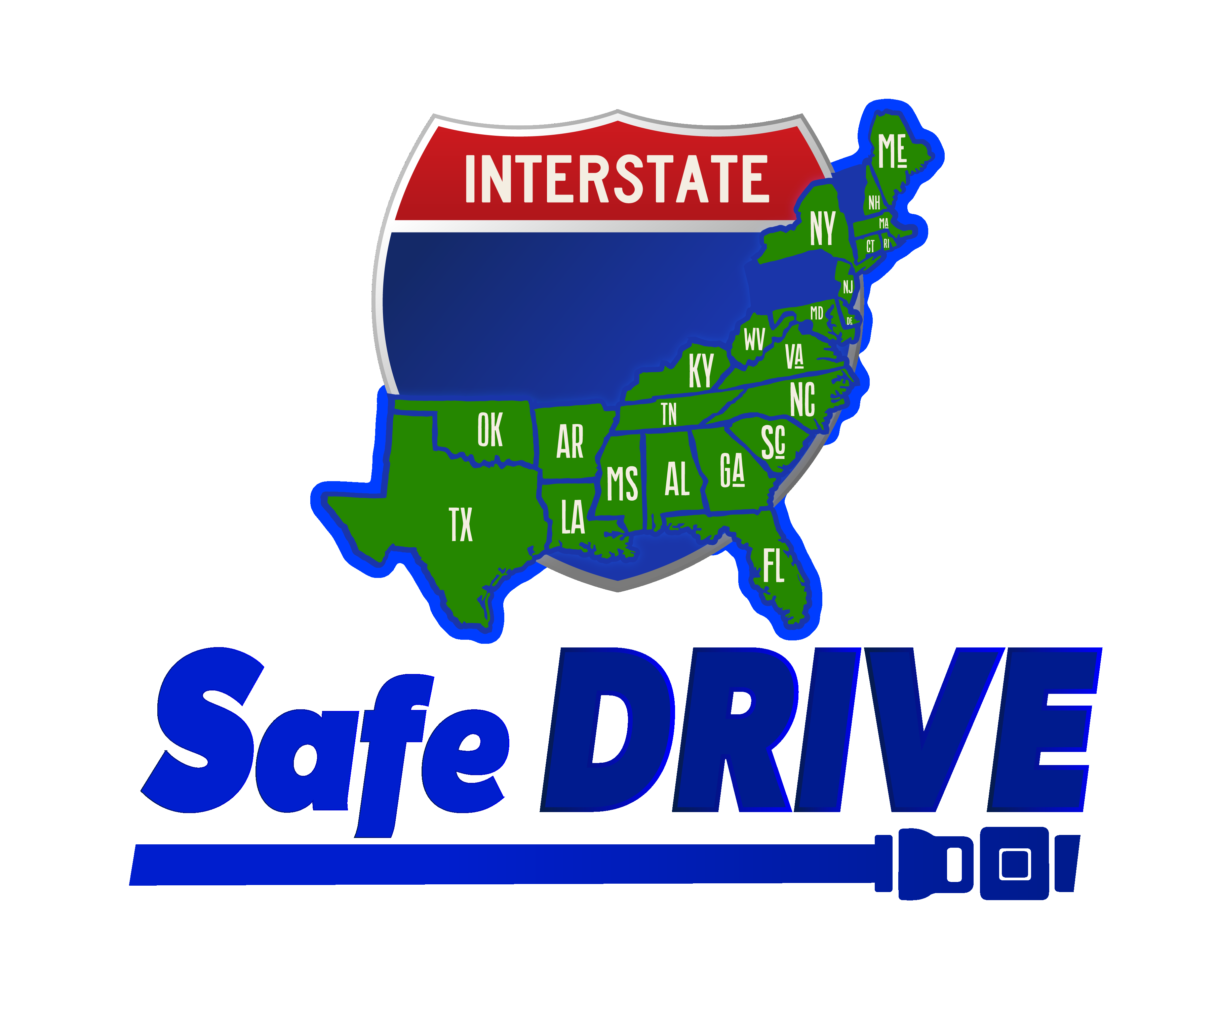

Slide 20
Operation Safe D.R.I.V.E.
Distracted, Reckless, Impaired, Visibility Enforcement
LSP is participating in Operation Safe DRIVE in an effort to increase regional traffic enforcement along all Interstate Systems.
Operation Safe DRIVE focuses on driver violations and reducing unsafe driving behavior. This operation is conducted quarterly in conjunction with states located in the southeastern part of the country.
LSP will have quarterly traffic enforcement details throughout the state during each enforcement Wave.
Notes:
Instead of waiting on Operation Safe drive, LSP can conduct its own traffic enforcement details. My region use to use an unmark car and a supervisor would check drivers for cell phone use, seatbelt, speed and any other distracted driving. Would like to use our air support.

Slide 21
“Move Over” Enforcement Initiative
The joint enforcement initiative Move Over Campaign aims to raise awareness about the critical importance of the "move over" law, which requires drivers to change lanes or slow down when approaching vehicles stopped on the side of the road, particularly emergency and roadside assistance vehicles. This campaign highlights the risks faced by law enforcement officers, tow truck operators, and other roadside workers who are often vulnerable to being struck by passing vehicles.
Notes:
Instead of waiting on Operation Safe drive, LSP can conduct its own traffic enforcement details. My region use to use an unmark car and a supervisor would check drivers for cell phone use, seatbelt, speed and any other distracted driving. Would like to use our air support.

Slide 22

Notes:
Instead of waiting on Operation Safe drive, LSP can conduct its own traffic enforcement details. My region use to use an unmark car and a supervisor would check drivers for cell phone use, seatbelt, speed and any other distracted driving. Would like to use our air support.

Slide 23
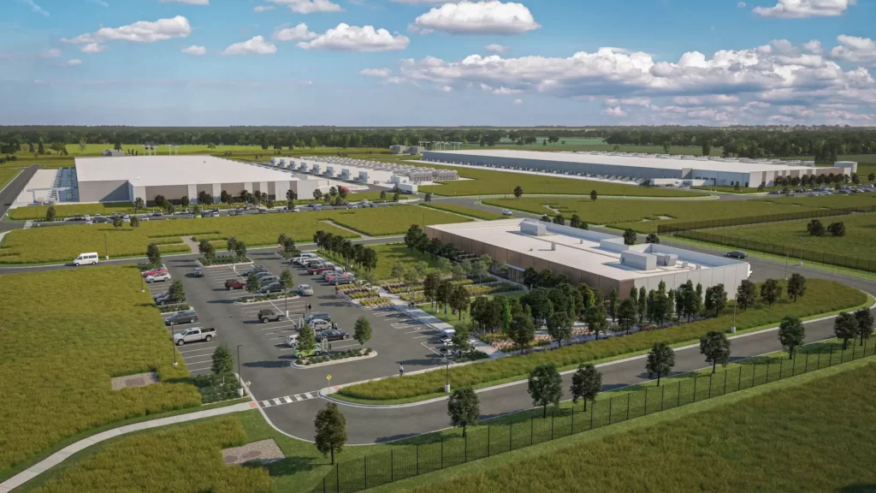
Emerging CMV Traffic Concerns
Meta's largest project is an AI-optimized "Hyperion" campus in Louisiana.
Location: The data center is under construction on a 2,250-acre site near Holly Ridge in Richland Parish, Louisiana.
Size and cost: At a projected cost of $10 billion, the campus will span 4 million square feet and will be the largest data center in Meta's global fleet.
Power and infrastructure: The facility will initially draw 2 gigawatts of power, with potential expansion to 5 gigawatts, requiring new on-site natural gas plants and transmission upgrades.
Notes:
Instead of waiting on Operation Safe drive, LSP can conduct its own traffic enforcement details. My region use to use an unmark car and a supervisor would check drivers for cell phone use, seatbelt, speed and any other distracted driving. Would like to use our air support.

Slide 24
2025 LSP TSS CMV Seizures
25 kilograms of cocaine seized in Calcasieu Parish during a motor carrier inspection.
200 lbs of marijuana, 7 grams of cocaine, and $1.2 million in currency related to the proceeds of trafficking in West Baton Rouge Parish seized during a motor carrier inspection.
74 kilograms of cocaine seized in St. Tammany Parish during a motor carrier inspection
Notes:
Instead of waiting on Operation Safe drive, LSP can conduct its own traffic enforcement details. My region use to use an unmark car and a supervisor would check drivers for cell phone use, seatbelt, speed and any other distracted driving. Would like to use our air support.

Slide 25
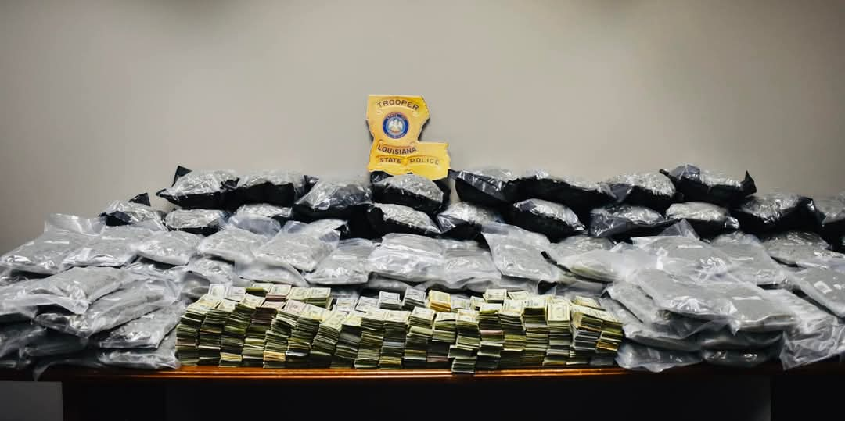
200 lbs of marijuana with 1.2 million in currency
Notes:
We will transition to safe spec

Slide 26
Crash Reduction
From fiscal year 2024-2025, Louisiana exhibited a 4.25% decrease in fatal CMV crashes, from 94 to 90.
LSP TSS has increased its traffic enforcement efforts in the past three years, leading to a sharp reduction in CMV crashes and fatalities.
Notes:
Increase in crashes probably due to COVID-19. Data given by CARTS

Slide 27
CMV Crash Reduction
Fiscal Year | Fatality CMV Crashes | Injury CMV Crashes | Total CMV Crashes
2022 | 111 | 2,033 | 4,045
2023 | 94 | 1,431 | 3,692
2024 | 94 | 1,421 | 3,790
2025 | 90 (-4.25%) | 1,416 | 3,592(-5.25%)

Slide 28
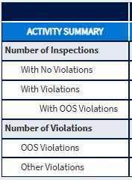
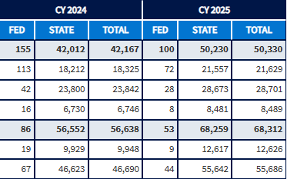
LSP Inspection Data

Slide 29
LSP Inspection Data
In calendar year 2025, LSP TSS conducted 50,230 roadside inspections. 21,557 (43%) of those inspections resulted in no violations, successfully passing the roadside inspection.

Slide 30
CMV Traffic Enforcement
Calendar Year | Traffic Enforcement Inspections | Total CMV Inspections
2022 | 5,172 | 35,901
2023 | 7,599 | 36,659
2024 | 8,215 | 42,012
2025 | 8,804 (+7%) | 50,240 (+20%)

Slide 31
Compliance Review / New Entrant Safety Audit
Fiscal Year | Compliance Review Investigations | New Entrant Safety Audits
2022 | 113 | 664
2023 | 115 | 550
2024 | 72 | 357
2025 | 100 | 277

Slide 32
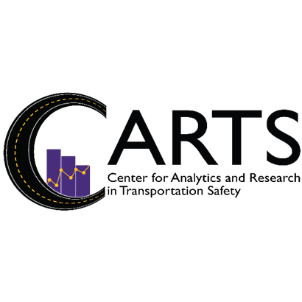
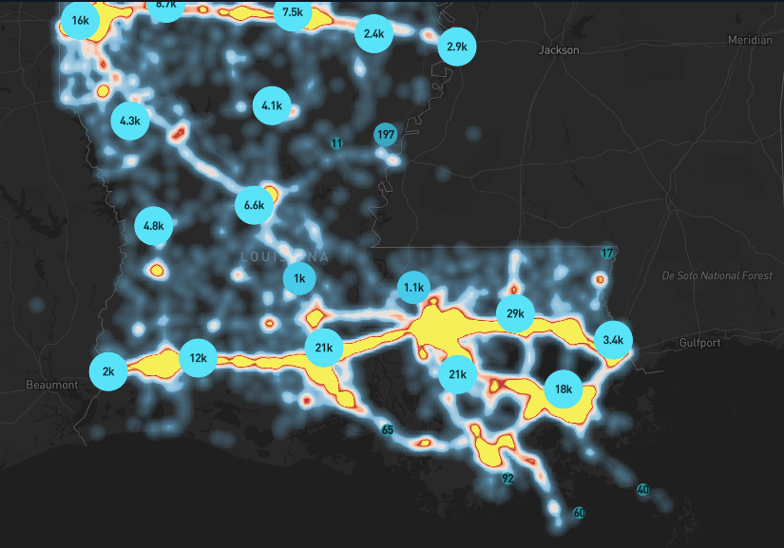
LSP partnership with LSU
to identify high crash corridors

Slide 33
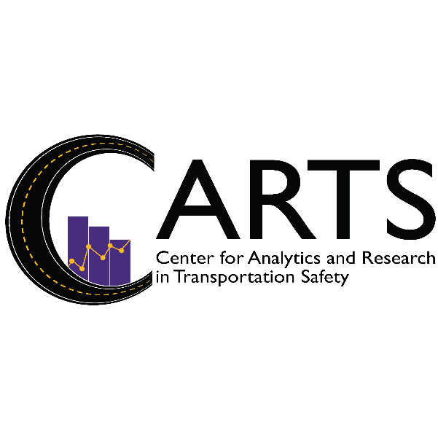
CMV involved Crashes in Louisiana 2021-2025
Produced by Center for Analytics and Research in Transportation Safety (CARTS) for Louisiana State Police

Slide 34
Total CMV involved Crashes in Louisiana 2021-2025
Crash Count
28% Of the total CMV involved crashes in Louisiana were Louisiana registered CMV’s and indicated as vehicle 1 on the crash report between 2021-2025
For Louisiana reported crashes*

Slide 35
Number of CMV involved crashes by month from
2021-2025
Crash Count
Month
For Louisiana reported crashes*

Slide 36
Number of CMV involved crashes by day of week from 2021-2025
Crash Count
Day of week
For Louisiana reported crashes*

Slide 37
Number of CMV related crashes by hour of day from
2021-2025
Crash Count
Hour
For Louisiana reported crashes*

Slide 38
CMV involved crash count by manner of collision from 2021-2025
Crash Count
For Louisiana reported crashes*

Slide 39
Total CMV involved crashes in Louisiana by severity compared to Louisiana registered CMV’s indicated as vehicle 1 on the crash report by severity from 2021-2025
Crash Count
For Louisiana reported crashes*

Slide 40
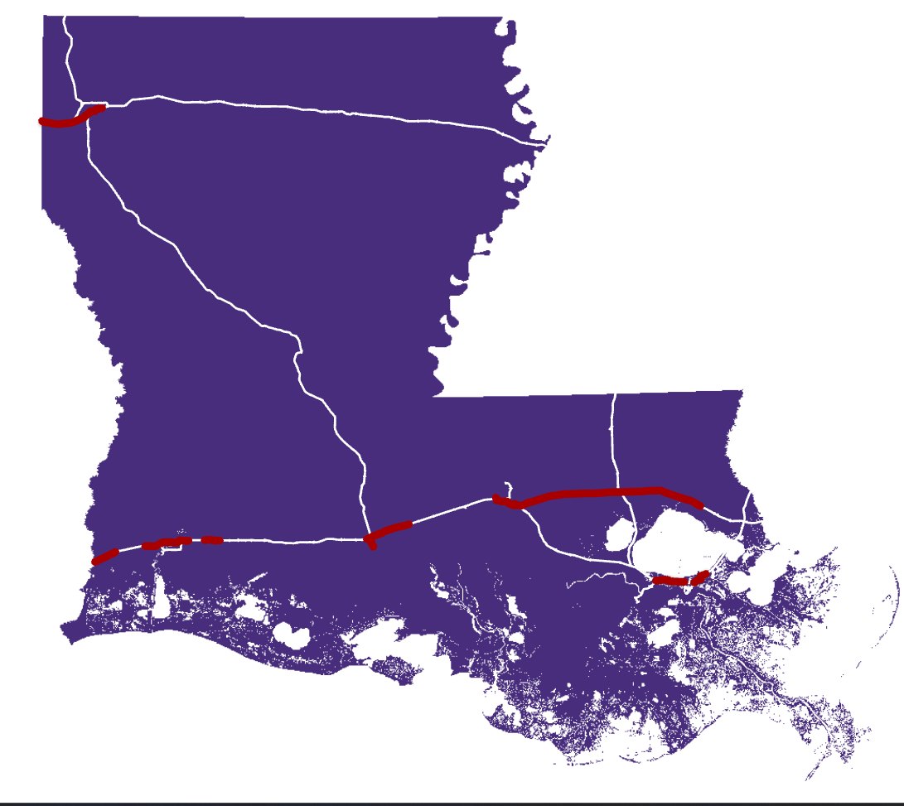



Common CMV crash locations
Concentration of CMV crashes

Slide 41
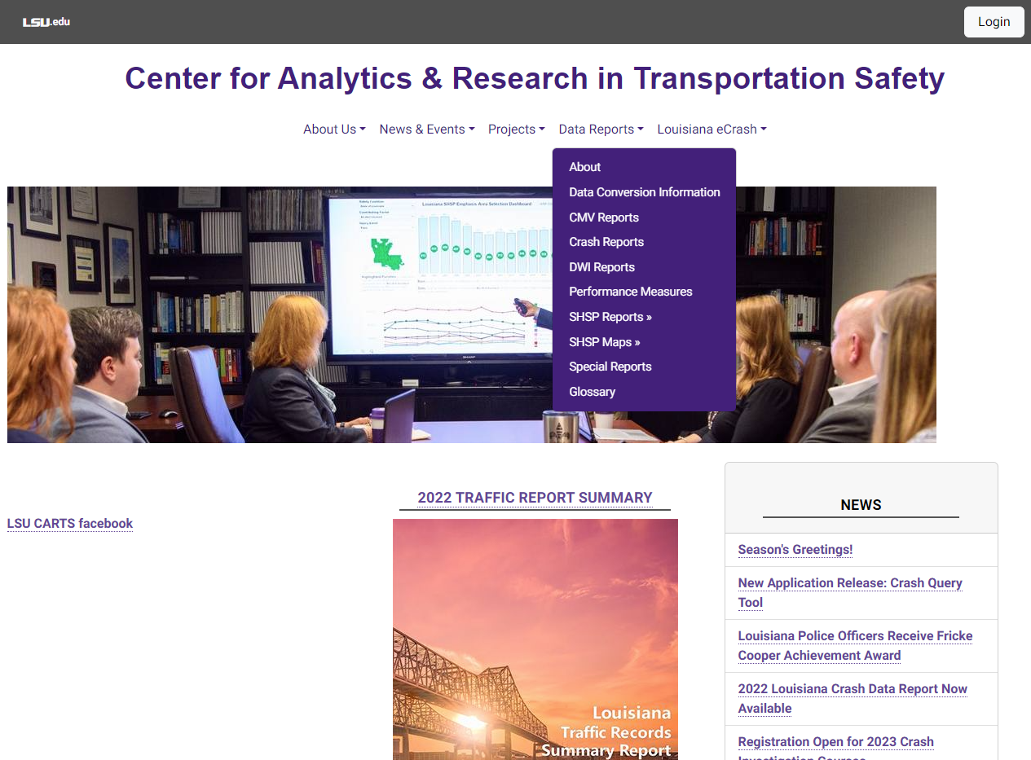
carts.lsu.edu

Slide 42
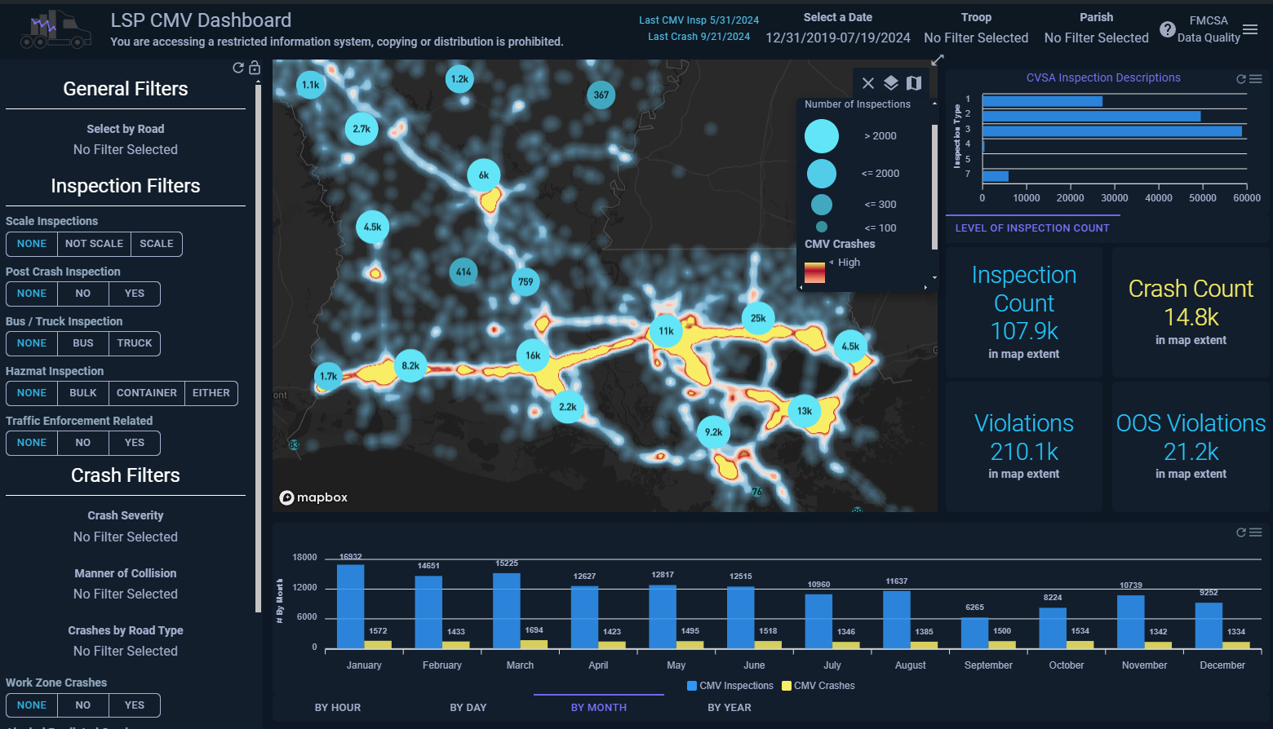

Slide 43
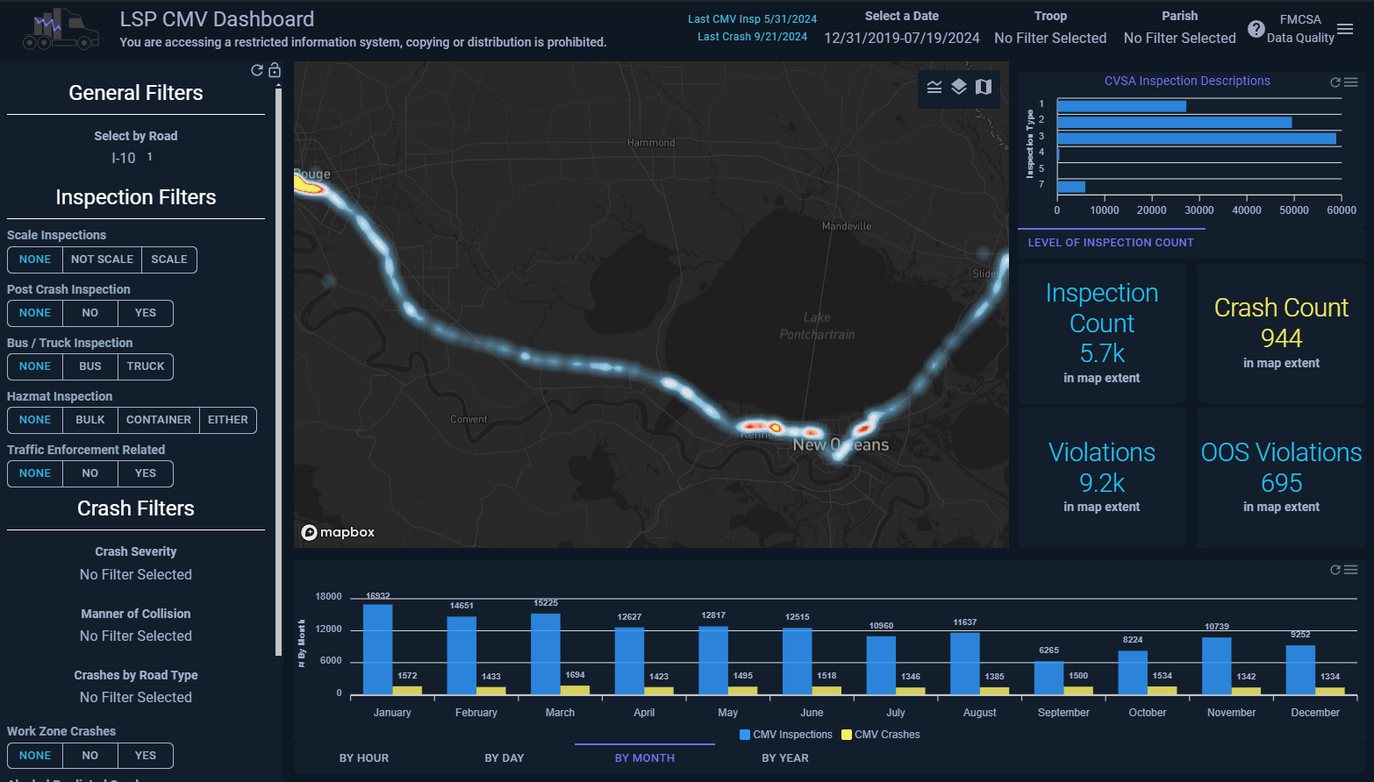

Slide 44
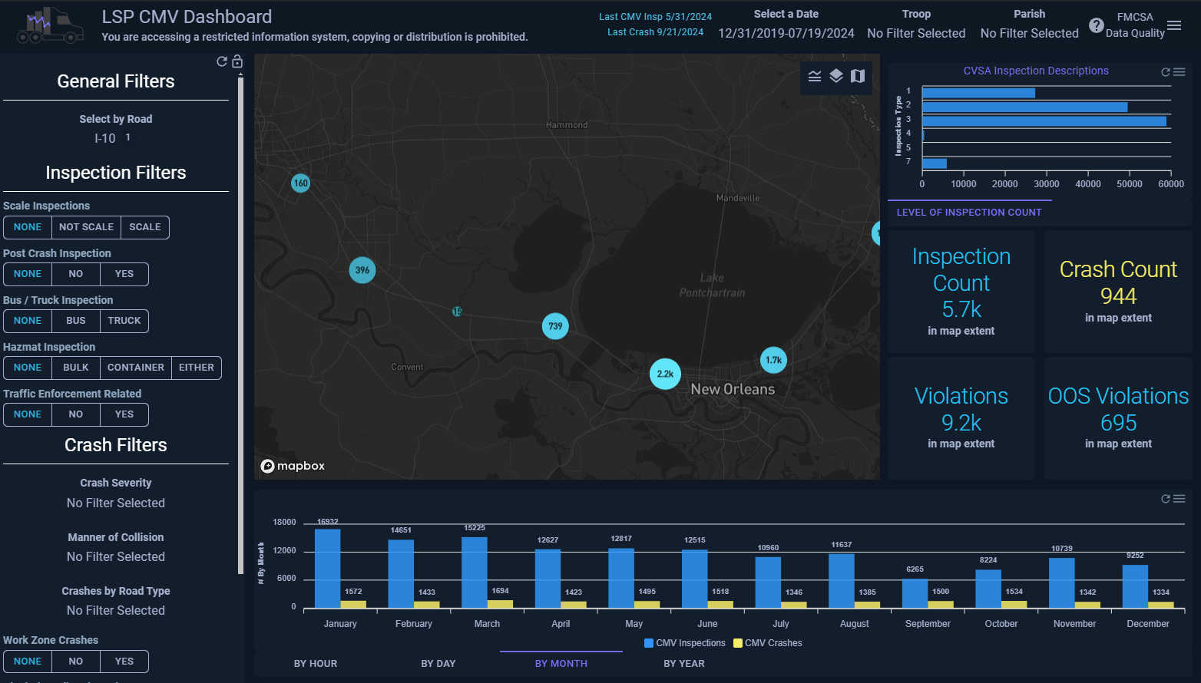

Slide 45
Important Dates!
Human Trafficking Awareness Initiative January 12-16
Safe DRIVE (Wave 1) January 13-15
Safe DRIVE (Wave 2) February 24-26
International Roadcheck May 12-14
CVSA Operation Safe Driver Week July 12-18
Safe DRIVE (Wave 3) April 14-16
CVSA Brake Safety Week August 23-29
Notes:
Explaining the DACH with admin law judges and masking with D.A. and judges.

Slide 46
Important Dates!
Safe DRIVE (Wave 4) May 12-14
Safe DRIVE (Wave 5) July 14-16
Safe DRIVE (Wave 6) September 1-3
Safe DRIVE (Wave 7) October 6-8
Safe DRIVE (Wave 8) November 17-19
Notes:
Explaining the DACH with admin law judges and masking with D.A. and judges.

Slide 47
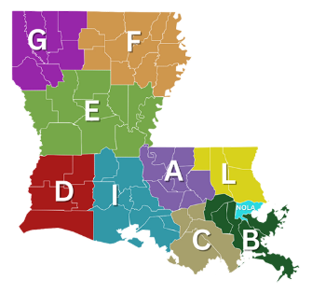
Contact your Regional TSS Office
Region I: (225)925-6113
Region II: (337)262-2220
Region III: (318)741-7416
Email:
LSP.Motor.Carrier.Safety@LA.gov

