Slide 2
Inside Washington: Federal Policy Shifts Shaping the Trucking Industry
John Lynch, Senior Vice President, Federation Relations
jlynch@trucking.org

Slide 3
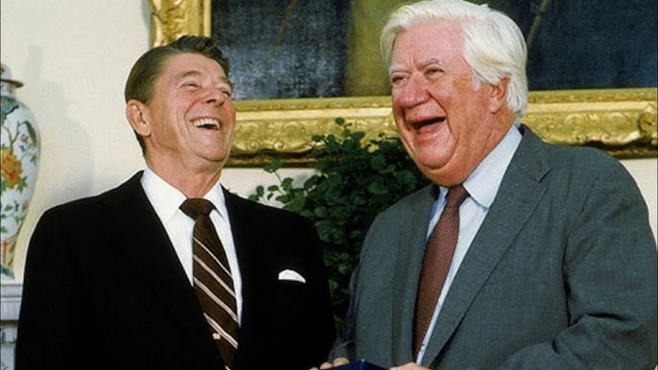
“All politics is local” – Tip O’Neill
"That's politics. After 6:00 we can be friends. but before 6 it's politics. – Ronald Reagan

Slide 4
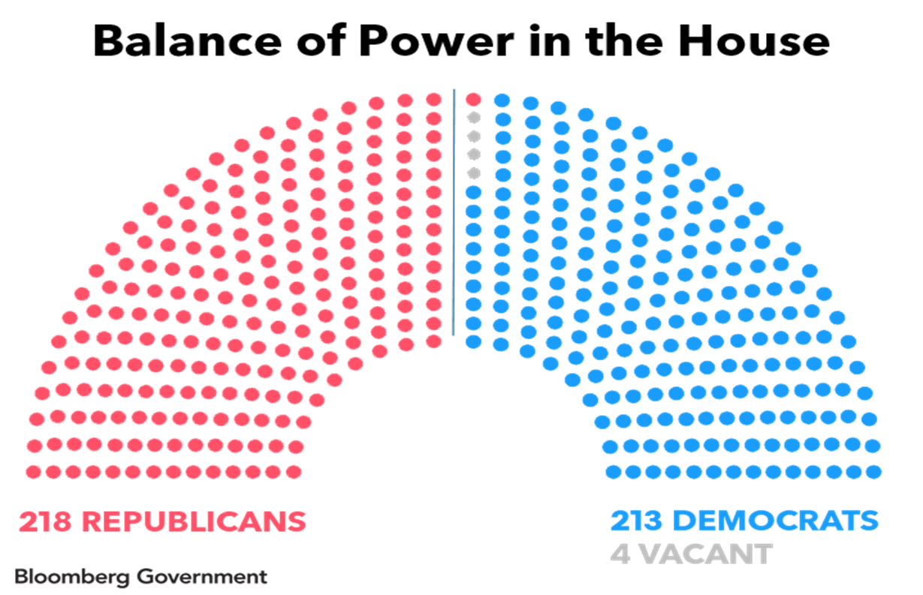
U.S. House of Representatives
House majority – 218 seats
375 seats already decided – gerrymandered districts
Charlie Cook: “Just 18 tossup races — four held by Democrats and 14 by Republicans…”
Over 10% of House members retiring

Slide 5
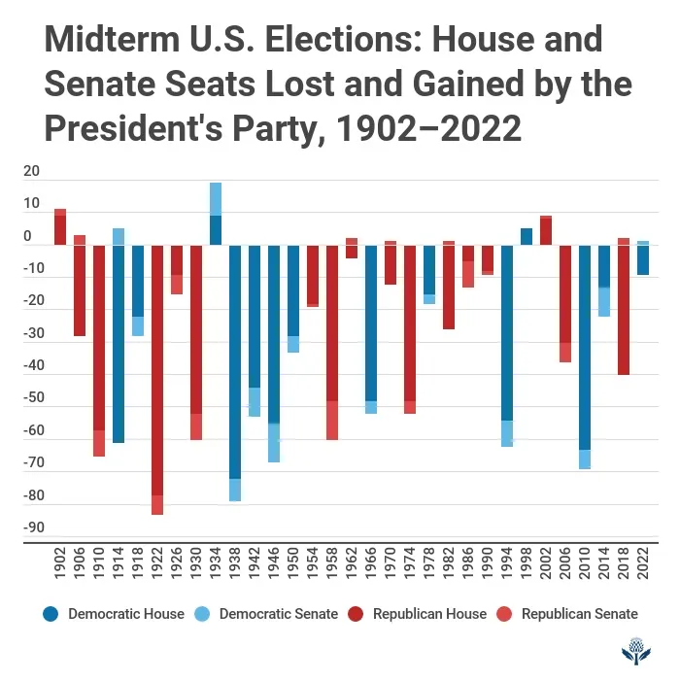
U.S. House of Representatives - Midterms
20 midterm elections since 1946.
President’s party lost House seats in 18 of those elections or 90% in past 80 years.
“All the presidents since Harry S. Truman whose job approval was below 50% in the month before a midterm election lost seats in the House. All of them.”*
Forty-seven current representatives retiring — 21 Dems & 26 Reps.
          Courtesy of Robert Strong, Senior Fellow, UVA

Slide 6
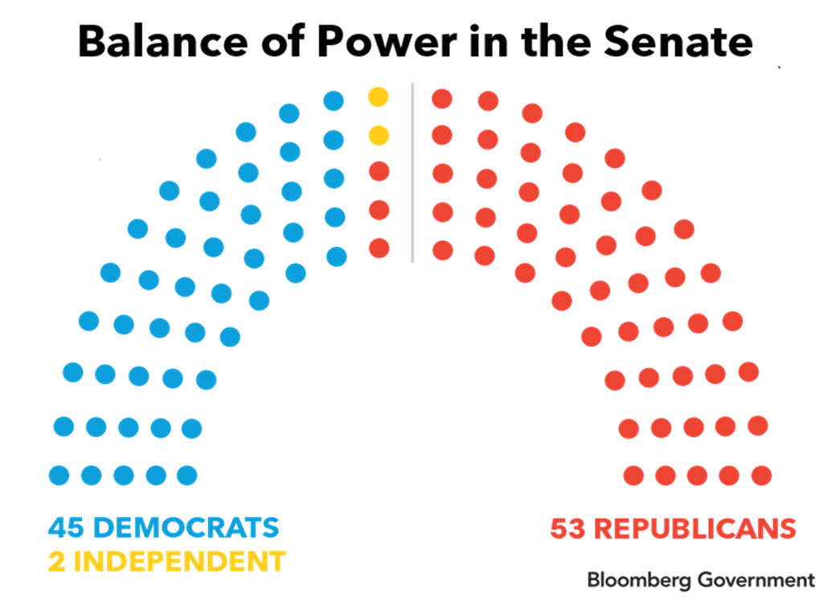
U.S. Senate

Slide 7
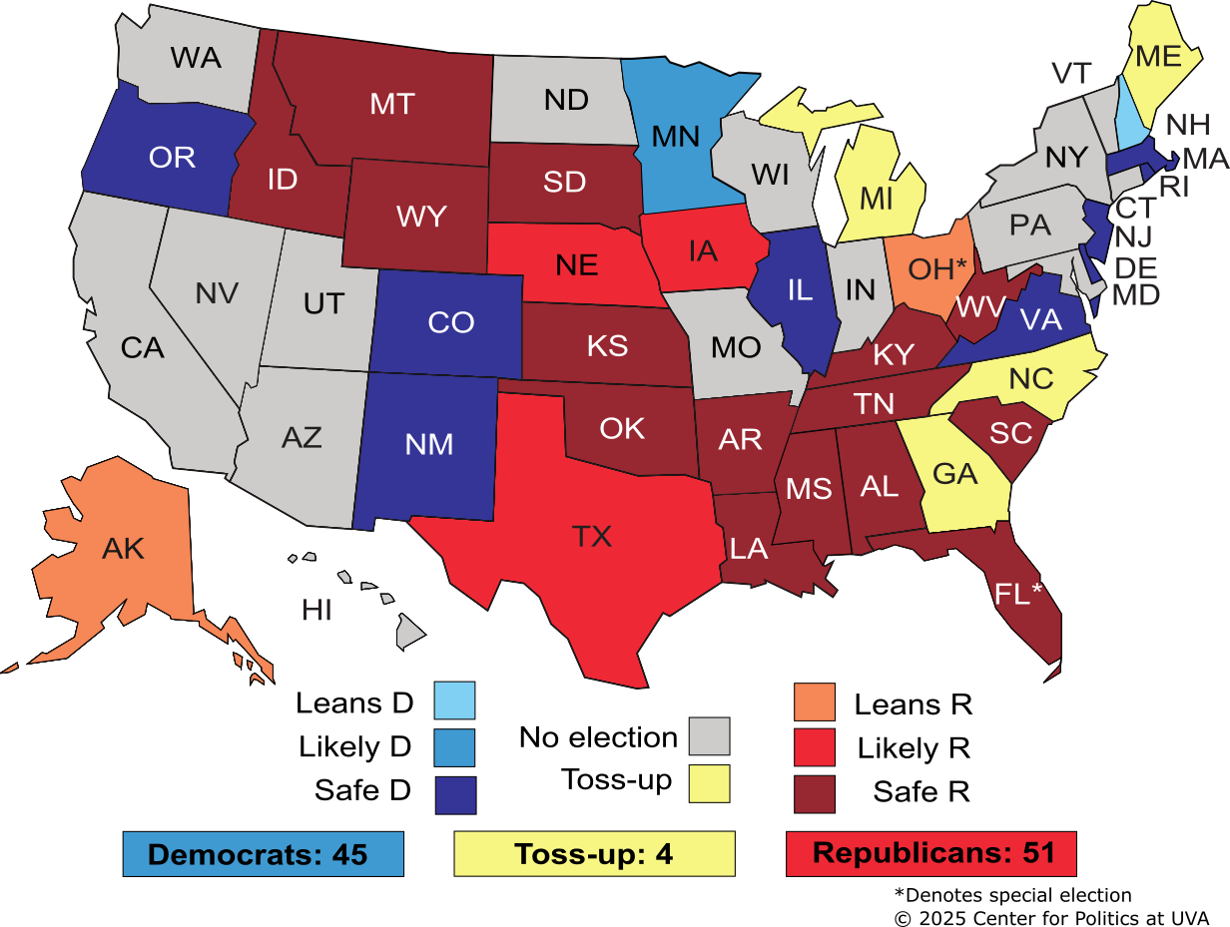
U.S. Senate - Midterms

Slide 8
ATA Mission Statement
The American Trucking Associations’ (ATA) mission is to be the unified voice for the trucking industry, advocating for policies that improve safety, security, environmental sustainability, and profitability, while also advancing the industry's image, efficiency, and competitiveness through research, education, and advocacy with policymakers.

Slide 9
ATA’s 2025 Victory List
ATA Testified 9x before Congressional Committees
Participated in 2 White House Bill Signing Ceremonies;
Congress preempts CA Electric Vehicle mandate;
EPA repeal of Greenhouse Gas Phase 3 rule;
Working with US DOT to close loopholes & strengthen oversight on driver qualification, training, licensing, ELD certification reform;
DOL rescission of Biden Administration Independent Contractor rule;
“One Big, Beautiful Bill”
Combatting Organized Retail Crime Act (CORCA);
$200m new truck parking grants;
Predatory Towing Study.

Slide 10
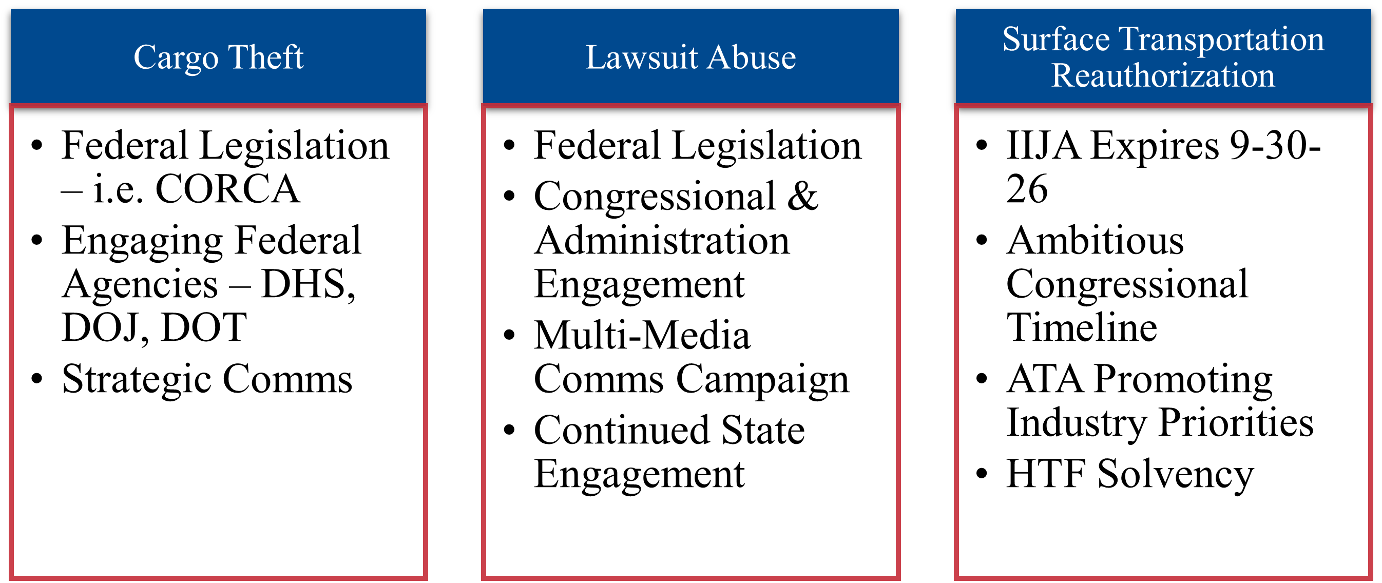
2026 Legislative Look Ahead:
Lawsuit Abuse, Cargo Theft, Surface Transportation Reauthorization

Slide 11



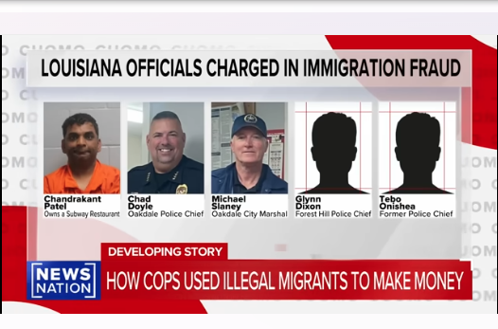
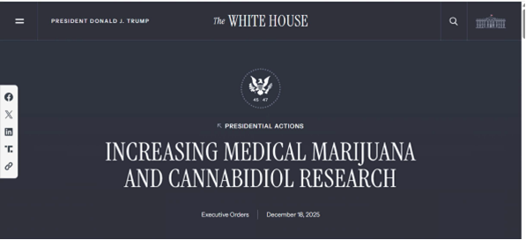
2026 Regulatory Issues
ELP Enforcement
CDL Mills Crackdown
ELDT Uniformity
ELD Certification Reform
Non-Domiciled CDL Final Rule

Slide 12
Economic News

Slide 13



THREE BIG SOURCES OF TRUCK FREIGHT
Factory & Industrial
Household Consumption/Retail
Construction: Home & Non-residential

Slide 14
CONSUMER SPENDING – GOODS VS EXPERIENCES
“K” Shaped Economy: Top 20% of earners now account for roughly two-thirds of all consumer spending.
Sources: BEA, ATA, S&P Markit
Forecast as of 1/7/2026 and subject to change.

Slide 15
Macro Economy Supports & Headwinds
Fiscal Policy
Monetary Policy
2026 Economic Policy
Fed cuts 2 more times with Chairman change
Fiscal policy support for next year
But tariff policy prevents the economy from surging
Overall recession unlikely, but freight economy remains subdued
Tariffs

Slide 16
EFFECTIVE TARIFF RATE
Annual Figures; 2025 is the Current Rate
Trucking Hit Directly and Indirectly
16.8%
Impacts on both on demand and inflation not fully felt yet.
Any benefits are well in the future, but costs hit much sooner.
Section 232 HD/MD truck tariffs. Plus, trailer chassis, tires.
IEEPA challenge may be a no-win situation. SCOTUS heard case last month.
Trump First Term
Sources: Yale Budget Lab & ATA

Slide 17
Fed Funds Interest Rate
Percent
Currently 3.5%.
Probably two more cuts next year because of “dovish” new Chair.
That would put rate to 3% after 2026 cuts.
But there are risks – Including goods inflation is already heating up and the potential for $2,000 tariff rebate checks.
Source: Federal Reserve & ATA

Slide 18
CONSUMERS: WHY IT’S A BAD TIME TO BUY
New Vehicles
New Homes
New Large Household Goods
Source: University of Michigan Survey Research Center

Slide 19
TRUCKING DEMAND

Slide 20
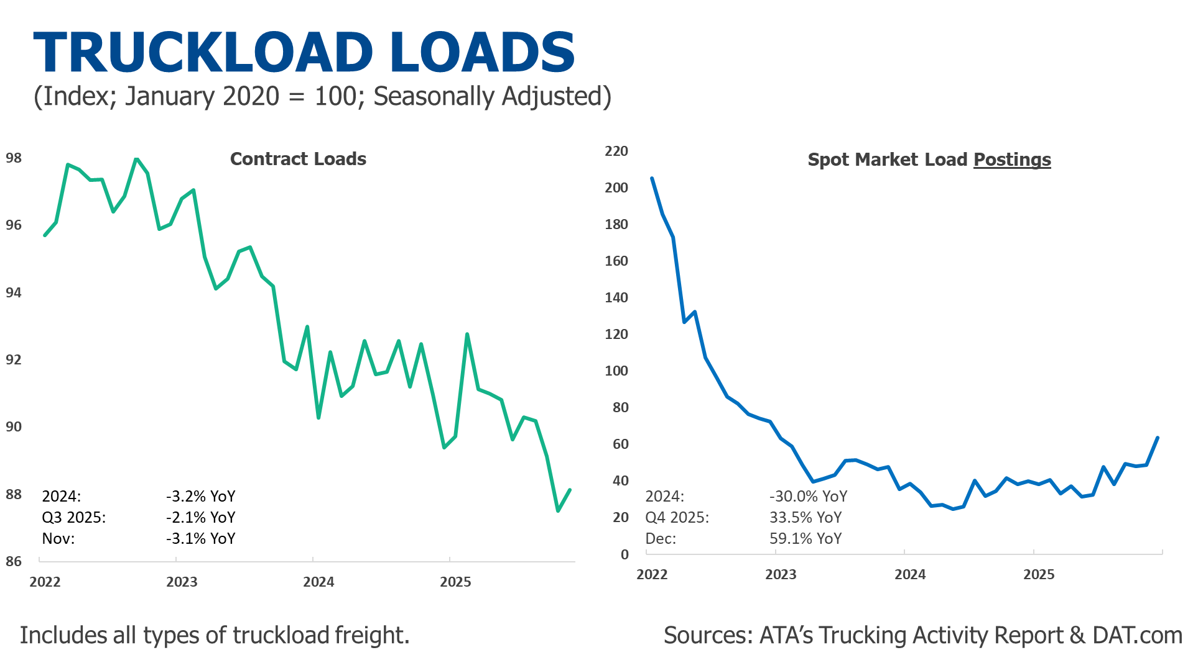

Slide 21
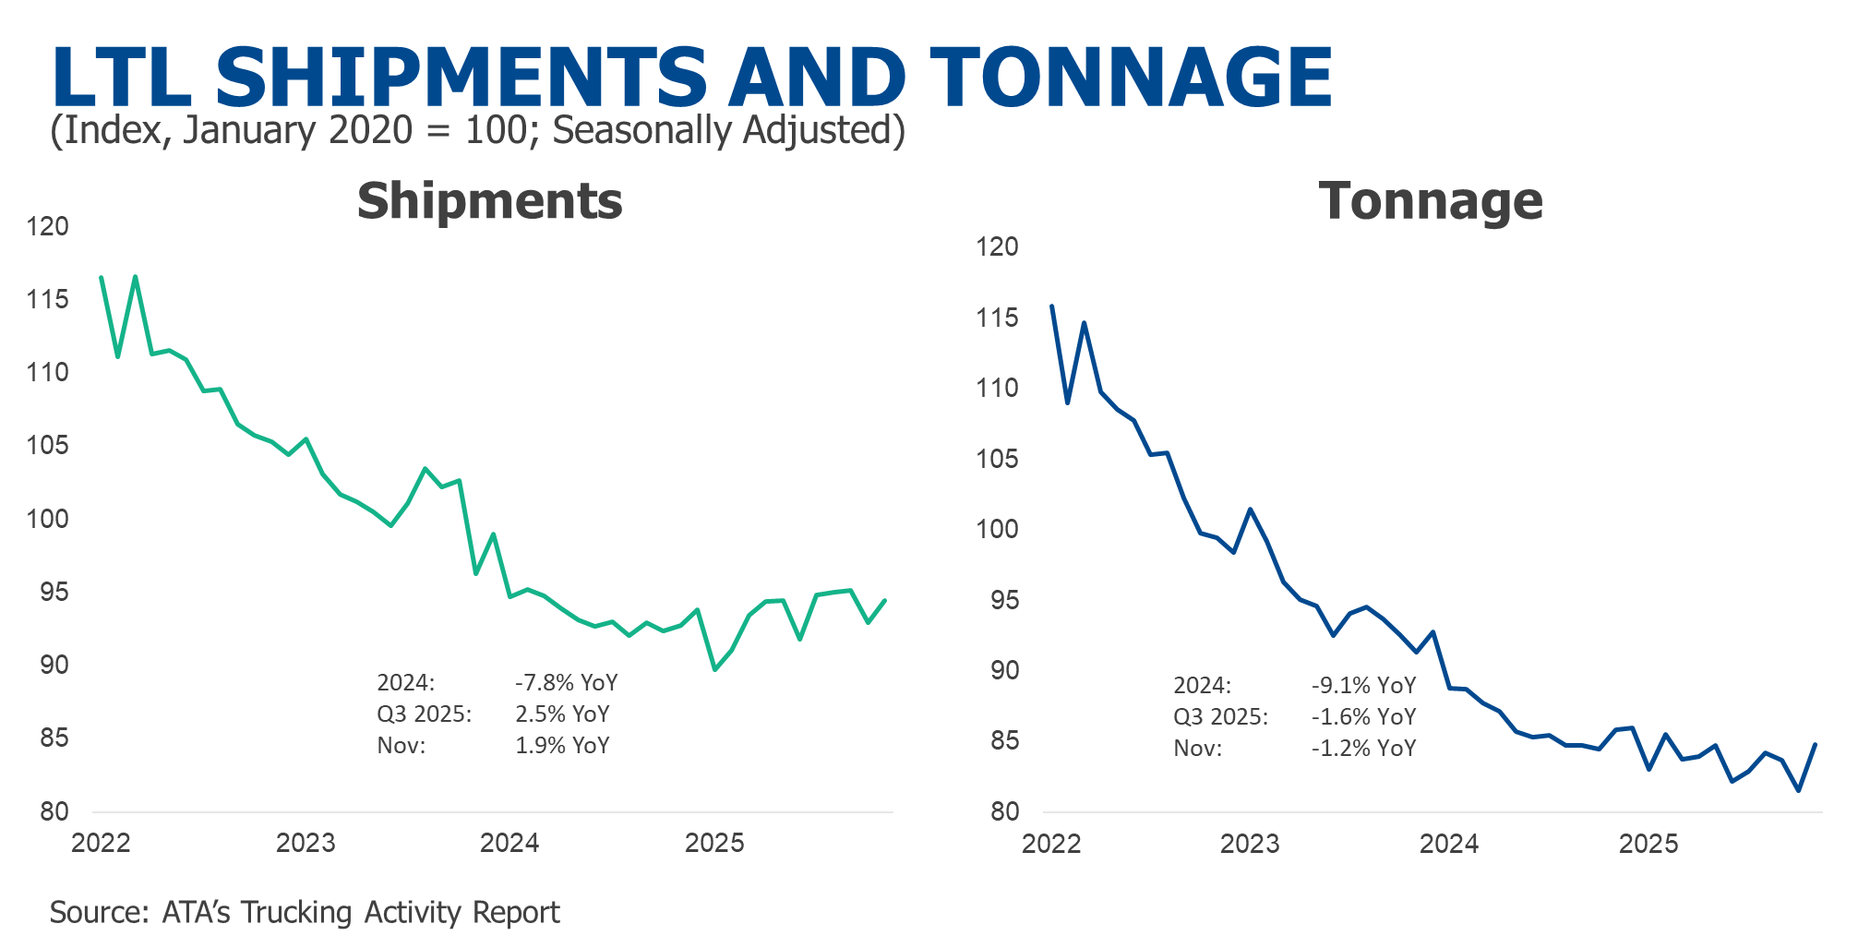

Slide 22
TRUCKING SUPPLY TRENDS –
MARKET PRESSURES

Slide 23
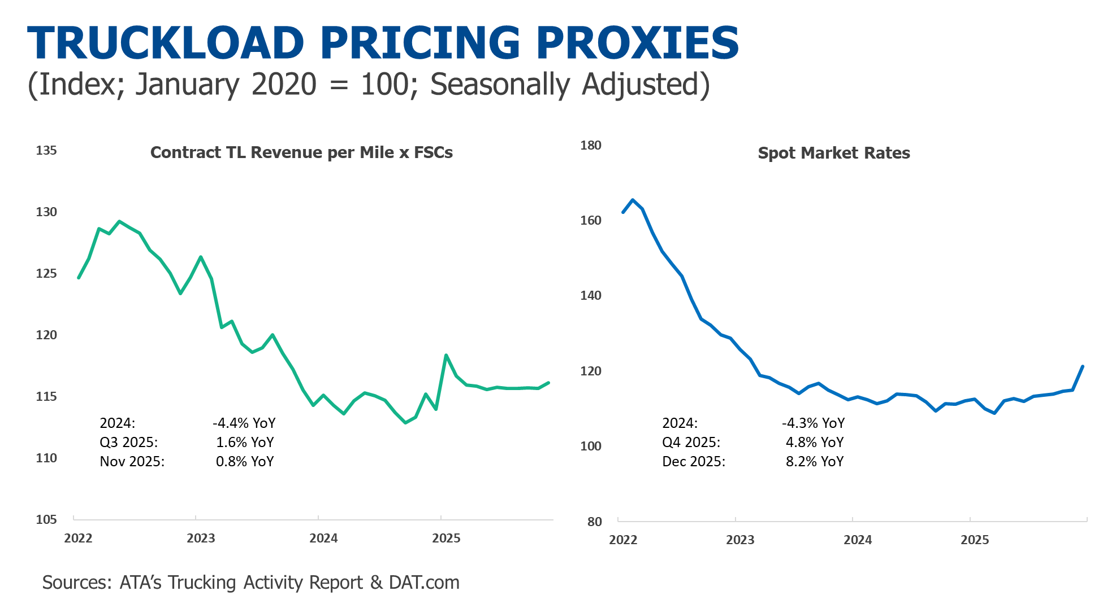

Slide 24
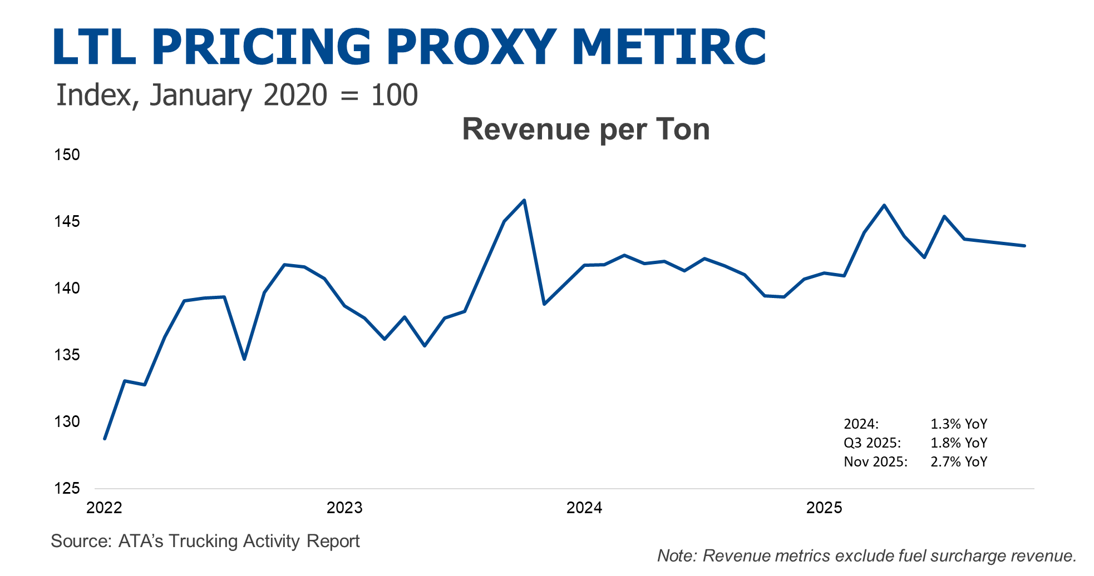

Slide 25
TRUCKING SUPPLY TRENDS –
COST PRESSURES

Slide 26
OPERATIONAL COST OF TRUCKING FOR TL, LTL, & SPECIALIZED
Includes: TL, Specialized, and LTL
Excludes: Fuel Expenses
Source: ATRI

Slide 27
TRUCKLOAD ONLY: OPERATIONAL COST OF TRUCKING VS FREIGHT RATE PROXY
26.0%
Difference
Sources: ATRI, ATA, and BLS
Excludes Fuel Expenses & FSCs

Slide 28
TRUCKING SUPPLY TRENDS

Slide 29
PRODUCTION & NONSUPERVISORY EMPLOYEES:
General Freight Long-Distance TL & LTL
Employee Driver Proxy;
Excludes I.C.s
Down 4.5% or 31,500 from pre-pandemic high.
Off 7.7% or 55,700 from 2022 high point.
Sources: DOL & ATA

Slide 30
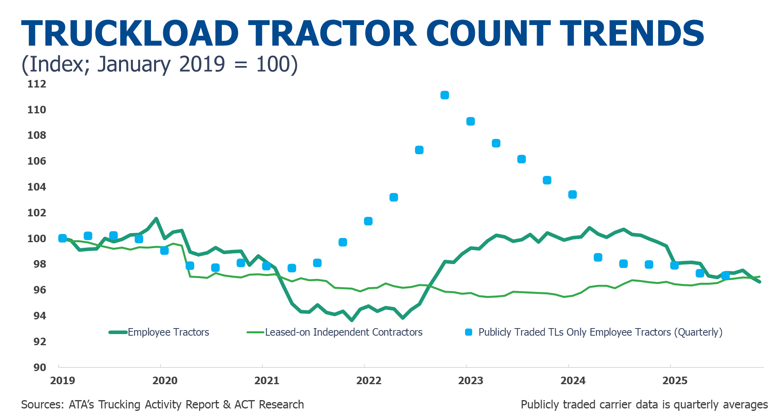

Slide 31
U.S. Class 8 Tractor Retail Sales Trends
Combination of better rates and a mini pre-buy before 2027 EPA’27 revised Clean Truck regulation (est. +$10k/truck) leads to a modest increase in tractor sales this year. Despite the gain, sales remain subdued as equipment prices have increased significantly (environmental regs and now tariffs) and freight demand remains soft.
Source: ACT Research

Slide 32
FACTORS IMPACTING FOR-HIRE SUPPLY
Supply Had Been Slow to Leave
Lenders didn’t want the used equipment – but this is changing.
Small fleets/I.C.s had decent cash flow even if they were losing money.
Unlike past down cycles, it is easier to get freight even if they lost money on the load.
Private fleet growth has finally ended and is reversing, which will help for-hire carriers.
Supply Reductions Could Accelerate Going Forward
Many small fleets/I.C.s are on the brink as they have no cushion.
Fleets have been trying to reduce costs as much as possible. Some of the efforts are good, but other costs cutting efforts will cause problems in the long-run, like deferred maintenance.
Debt has been piling up. Some can’t afford new trucks even before tariffs. Maintenance is going to catch up with them eventually. Freight rates fell, but costs jumped. Interest rates won’t go down enough to drastically reduce costs. Etc., etc.
Assume freight levels don’t improve as a result of the tariffs, but costs remain high also because of the tariffs, we could see an acceleration in failures.
Driver market should shrink as ELP, Non-Domiciled CDLs, and Visa policies change.
Truck sales to remain below replacement rates with new tariffs.
Ending ELD self-certification?
Illegal Capacity
Some fleets are illegally using Mexican B-1 drivers to haul domestic loads, known as cabotage. ATA is working with the Department of Homeland Security to crack down on this illegal activity. This has added to capacity when it should have been falling. Recent bust in AZ.

Slide 33
Demand vs Supply Trucking Recoveries
Demand based recoveries are “easy”
Supply based recoveries are “difficult”
Unfortunately, we don’t see a surge in trucking freight services demand coming in 2026
But the continued reduction in supply should help

Slide 34
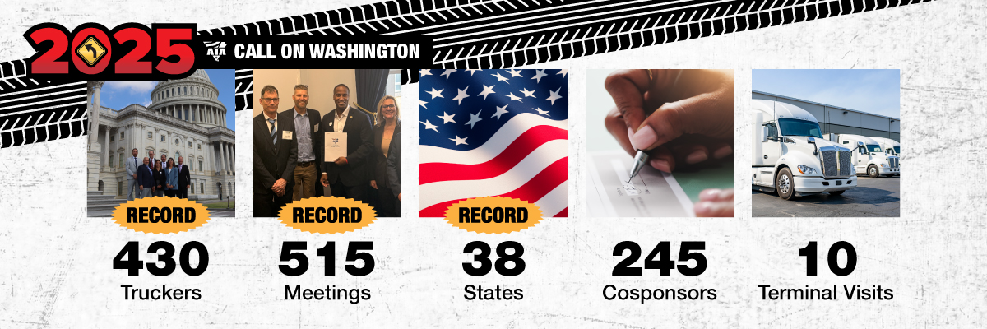
See ya’ in February!

