Slide 1


LOUISIANA MOTOR TRANSPORT ASSOCIATION
BUILDING CAPACITY
The Government
Contracts Lane
A 30-Day Strategy
January 2026

Slide 2
AGENDA
Today's Roadmap
01
The Opportunity
04
Real-World Success
Understanding the $760B federal market and Louisiana's strategic position
Case studies and proven growth strategies from local carriers
02
Three Pillars
05
30-Day Action Plan
Operational, Financial, and Contracting capacity essentials
Your quick-start checklist for immediate implementation
03
Resources
Strategic Steps to Government Contracting Success
Local support network and available assistance programs

Slide 3
THE OPPORTUNITY
$760B Federal Market—
Louisiana is in the Middle
Government freight spending keeps rising—
capture your piece of the pie. It does not demand perfection – it demands people, systems, capital and compliance
$760B
18%
4
Federal Market
Growth Forecast
Key Demand Drivers

Slide 4
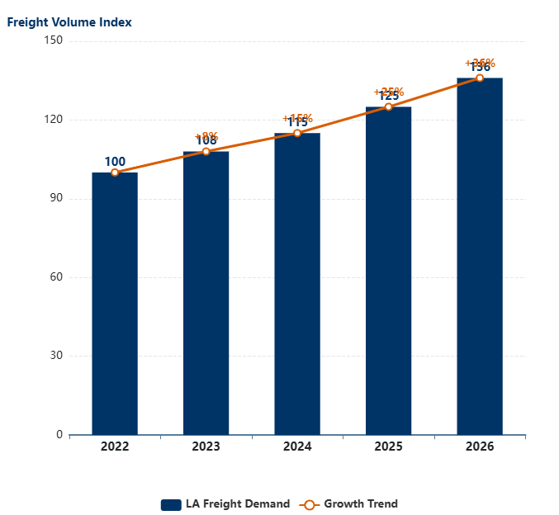
MARKET DYNAMICS
Ports
Freight Demand in LA ↑ 18% 2024-26
Strategic Gulf Coast location with the Port of New Orleans, Port of South Louisiana, and Port of Lake Charles handling massive cargo volumes daily.
Louisiana Freight Growth Forecast
LED Economic Projections
Plants
Petrochemical corridor along the Mississippi River creates constant demand for raw material inputs and finished product shipping.
Highways
Interstates 10, 20, 49, and 55 converge in Louisiana, making it a critical trucking hub for Southeast and Southwest regions.
Disaster Response
FEMA and emergency management contracts require immediate freight capacity during hurricane season and natural disasters.

Slide 5
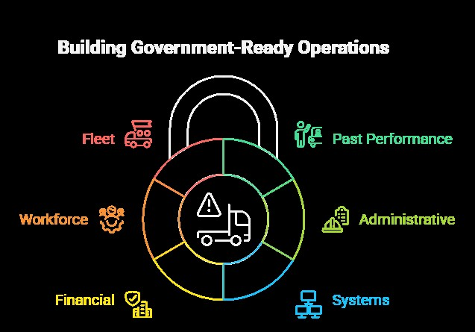
BUILDING BLOCKS
Past Performance
Capacity = Stronger Business
Your track record of successful deliveries and satisfied customers. This is the foundation that all other capacity is built upon.
Six essential layers to build government-ready operations
Administrative
Documentation, compliance records, safety protocols, and organizational structure required for government oversight.
Systems
Technology infrastructure for tracking, communication, reporting, and operational management.
Financial
Cash reserves, credit access, bonding capacity, and financial stability to handle government payment cycles.
Workforce
Qualified drivers, mechanics, and support staff with proper licensing and training.
Fleet
Well-maintained tractors, trailers, and equipment meeting all safety and regulatory standards.

Slide 6
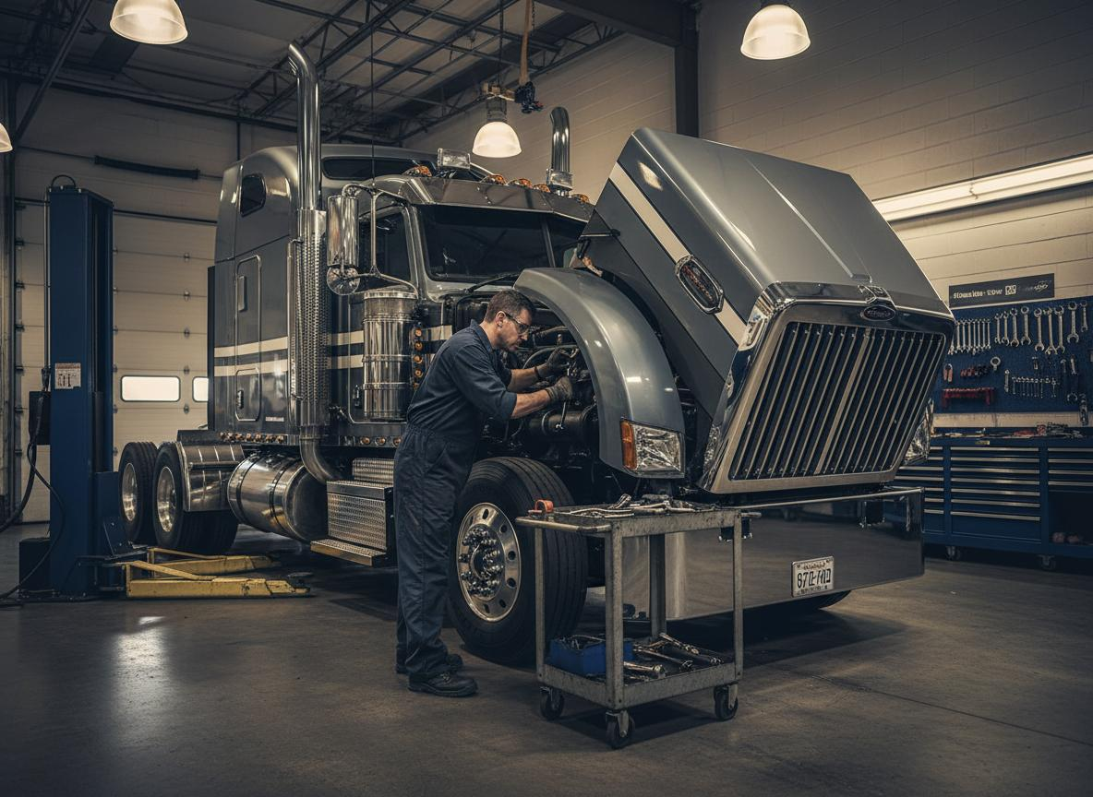


STRATEGIC FRAMEWORK
Three Pillars to Win Contracts
Master these three areas to build sustainable government contracting success
1
2
3
Operational Capacity
Financial Capacity
Contracting & Compliance
Maintain satisfactory FMCSA safety rating and compliance record
Build 90-day cash reserves to bridge government payment cycles
Complete SAM.gov registration and maintain active profile
Secure $1M+ liability insurance and required surety bonding
Establish line of credit BEFORE bidding on large contracts
Match NAICS codes to your service capabilities exactly
Achieve >95% on-time delivery performance consistently
Maintain clean financial statements and audit-ready books
Read bid requirements carefully—delivery windows, page limits
Pro Tip: Keep a digital Contract Binder—saves 2 hours per bid.
Remember: Open line of credit BEFORE
you bid.
Golden Rule: Read twice, bid once.

Slide 7

PILLAR 1
Operational Capacity
The foundation of your government contracting readiness
Satisfactory FMCSA Rating
Your FMCSA safety rating is your license to operate in government contracting. Maintain a "Satisfactory" rating by staying current on inspections, driver qualifications, and hours-of-service compliance. A conditional rating can disqualify you immediately.
$1M Liability Insurance
Government contracts require minimum $1M commercial liability coverage and often additional surety bonding. Work with an insurance broker experienced in government work to ensure your policy meets federal requirements and includes appropriate endorsements.
On-Time Delivery >95%
Government agencies track performance meticulously. Maintain 95%+ on-time delivery through GPS tracking, proactive communication, and contingency planning. Past performance data becomes your competitive advantage in future bids.
Pro Tip: Keep a digital Contract Binder with all your FMCSA documents, insurance certificates, and performance records—saves 2 hours per bid submission.

Slide 8
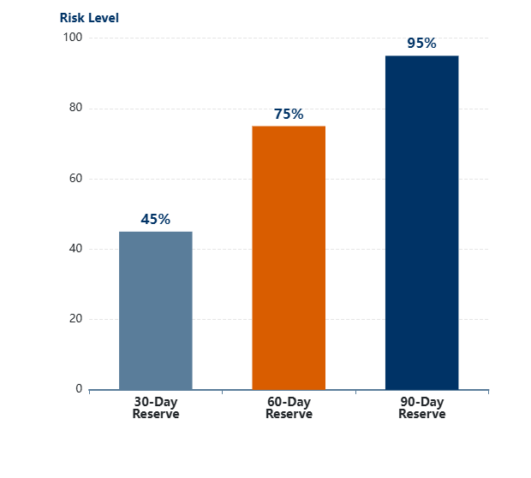
PILLAR 2
Financial Capacity
The Government Payment Reality
Build the financial bridge to handle government payment cycles
Federal agencies pay on 30-day cycles, but your first payment often takes 45-60 days. You need cash to cover fuel, payroll, and expenses during this gap.
Build 90-Day Cash Bridge
Recommended cash reserves for government contracting
30-Day Reserve: Minimum
Absolute minimum for small contracts. Covers one payment cycle but leaves no margin for delays or growth.
60-Day Reserve: Recommended
Safe buffer for most carriers. Handles payment delays and allows you to bid on mid-size contracts confidently.
90-Day Reserve: Ideal
Competitive advantage territory. Enables large contract execution and rapid scaling without cash flow stress.
Open line of credit BEFORE you bid—banks lend to healthy companies, not desperate ones.

Slide 9
PILLAR 3
Contracting & Compliance
Navigate SAM.gov and bid requirements like a pro
SAM.gov Opportunity Example
Common Bid Mistakes
Key elements to verify before bidding
Wrong NAICS: Bidding outside your certified codes
1
Capacity Overstretch: Promising more trucks than available
NAICS Code Match
Verify your services align with the listed NAICS code. Mismatches disqualify immediately.
Missing Signatures: Forgetting required certifications
Late Submission: Upload issues cause missed deadlines
2
Delivery Window
Check pickup/delivery requirements against your route capacity. Can you realistically meet the timeline?
Bid Strategy Tips
Start with smaller contracts to build past performance
3
Page Limit & Format
Bid only on lanes you can service profitably
Stay within page limits. Use required fonts and formatting. Technical rejections are common.
Partner with experienced carriers for first few wins
"Read twice, bid once"

Slide 10
WHY GOVERNMENT WORK?
Four Immediate Advantages
Steady Payclock
Predictable Routes
Government contracts pay on reliable 30-day cycles. Unlike commercial freight where payment can be unpredictable, federal and state agencies maintain strict payment schedules, ensuring your cash flow remains consistent and predictable month after month.
Federal contracts often run 3-5 years with consistent lanes. This stability allows you to optimize your fleet operations, plan driver schedules effectively, and reduce the empty miles that eat into profitability.
Less Rate Swing
Leverage Compliance
Government freight rates are negotiated annually, shielding you from the daily spot market volatility that can destroy margins. This pricing stability makes it easier to forecast revenue and plan for growth investments.
The same compliance work opens doors to more bids. Once you establish SAM.gov registration, safety ratings, and insurance requirements, you can leverage these credentials across multiple government opportunities.

Slide 11
SUPPORT NETWORK
Louisiana Help is Everywhere
Tap into these resources to accelerate your government contracting journey
LMTA
LED
LED
LA APEX
Hudson
Your Business
DBE
Veteran
DOTD
LMTA
LA APEX
LED
DOTD
Industry association, advocacy & training
Federal procurement technical assistance center
Economic development incentives
State transportation contracts

Slide 12
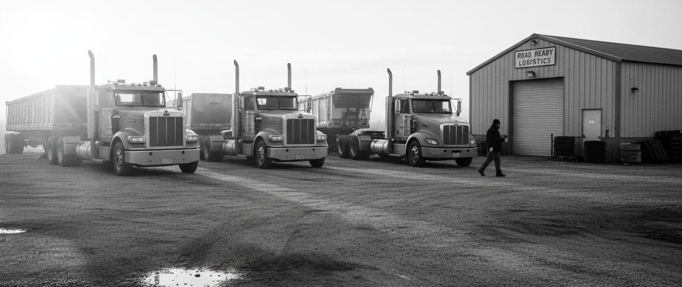

REAL-WORLD SUCCESS
Shreveport Carrier: $2M → $8M in 3 Years
TRANSFORMATION
DOD Contracts
YEAR 0
YEAR 3
$2M Revenue
$8M Revenue
6 trucks, local/regional work
22 trucks, multi-state operations
Sporadic cash flow, thin margins
Predictable revenue, 18% margins
No government experience
60% revenue from DOD contracts
"Start small, deliver perfectly, scale fast."
— Shreveport Carrier Owner

Slide 13
CASE STUDY
12-Truck Carrier's Government Contracting Entry
Six milestones from registration to 32% revenue growth
Month 1
Month 2
Month 4
Month 8
Month 12
Year 2
SAM.gov Registration
Capability Statement
GSA Schedule Win
FEMA Subcontract
Add 2 Trucks
32% Revenue ↑
Completed profile, selected NAICS codes, obtained
UEI number
Created professional capability statement highlighting
12-truck fleet
Awarded first GSA contract for regional freight services
Partnered with prime on disaster response contract during hurricane season
Revenue growth enabled fleet expansion to
14 trucks
Federal contracts drove $1.2M revenue increase
12
14
32%
Starting Fleet Size
Fleet After Year 1
Revenue Growth

Slide 14
LEARN FROM MISTAKES
Pitfalls to Avoid
Common mistakes that derail trucking companies entering government work
Chasing Every Bid
Ignoring Cash Flow
Don't scattershot bid on everything. Focus on lanes where you have competitive advantage and can deliver profitably. Quality over quantity wins in government contracting.
Growing broke is worse than not growing. Many carriers win contracts then can't cover fuel and payroll. Build your financial bridge before you bid, not after.
Missing Documents
Overstretching Fleet
One missing certificate kills your bid. Keep your Contract Binder current with insurance certs, FMCSA ratings, authority documents, and financial statements.
Don't promise 10 trucks when you have 6. Government contracts have strict capacity requirements. Bid what you can deliver, then scale up after you prove performance.
Forgetting Renewals
SAM.gov, insurance, authority—all expire. Set calendar reminders 60 days before deadlines. Nothing kills momentum like losing active status right before a big bid.

Slide 15
GET STARTED TODAY
Your 30-Day Quick-Start Checklist
Eight actionable steps to launch your government contracting journey
Update SAM.gov Profile
Secure Line of Credit
1
5
Register or refresh your System for Award Management profile. Verify UEI, address, and banking info.
Meet with your banker and establish working capital line. Get this before you need it.
Pick Your NAICS Codes
Review Insurance Coverage
2
6
Select codes matching your services (484121 for trucking). These determine which bids you can pursue.
Verify you have $1M+ liability coverage. Ask broker about government contract endorsements.
Draft Capability Statement
Contact LA APEX
3
7
Create a one-page professional document highlighting your fleet size, services, and differentiators.
Reach out to Louisiana’s federal procurement assistance center for free counseling.
Register with LaGov
Search Opportunities
4
8
Complete Louisiana state vendor registration to access state and local government opportunities.
Browse SAM.gov and LaGov for 2-3 small contracts matching your capabilities.
Snap a photo of this checklist—check one item per day. In 30 days, you'll be ready to bid.

Slide 16
GOVERNMENT CONTRACTING IS NOT COMPLICATED – IT’S STRUCTURED!
Your trucking business is already built on structure: You have the fleet, the drivers, and the operational know-how. If you build your capacity to take on government contracting requirements, position your company correctly, and pursue consistent opportunities, the government can become one of your most steady,
predictable and long-term customers.
CAPACITY = RESILIENCE

Slide 17

THANK YOU!
Evon Cook
Principal Consultant
GFACTOR STRATEGIC ADVISORS
Powered by Covenant Connection, LLC
Mobile: 225-978-5777
Office: 225-627-6397
Email: contact@covconnection.com
http:www.covconnection.com/DFactorSA

