Slide 1
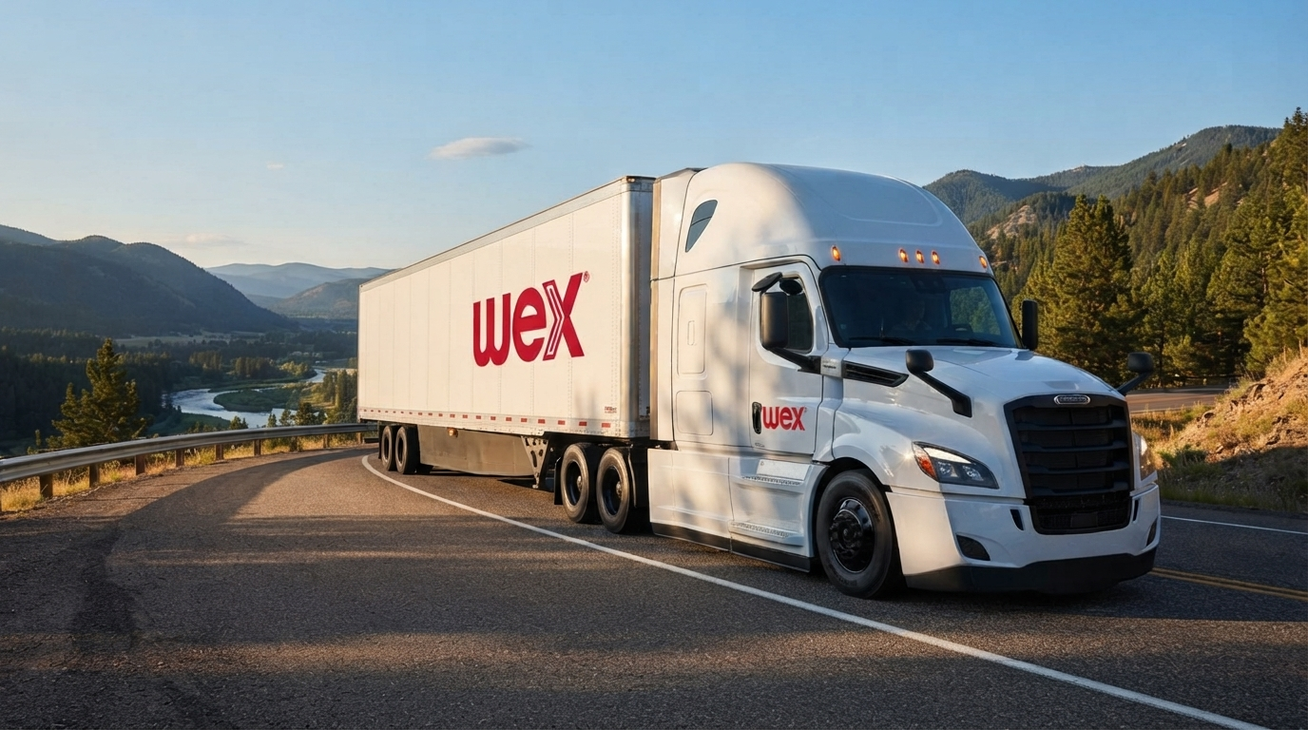
Factoring vs. Traditional Financing
LMTA
Cory Turner
WEX Capital Business Development Officer
October 13, 2026

Slide 2


Meet Cory Turner
Location
Passions & Hobbies
Family Life
Nashville, TN
Music City Base 🎸
Sports Addict
Avid Golfer ⛳️
Married + 3 Kiddos
Plus a New Dog 🐶
Education
Career Journey
MTSU ('06)
Finance Degree 🎓
Comdata → Crestmark Bank → WEX Capital
Extensive experience in Commercial Finance & Capital Solutions 💼

Slide 3



Who is WEX?
COMPANY OVERVIEW
CORE FOCUS
Based in Portland, Maine
40+ years in business
800K customers worldwide 📍
Fleets & Logistics Operators
We simplify the Business of Running a Business
By unlocking the value behind payments so freight carriers can make their business the best it can be 🚛
FLEET SOLUTIONS
CAPITAL & FINANCING
EFS / Fleet One
Industry-leading payment solutions 💳
WEX Capital
Provides financing to help increase cash flow
Page 3

Slide 4
The State of the OTR Freight Industry
ASSET COSTS
OTR Market Pulse
High Asset Costs
Semi Truck $200k+ / Trailer $75k+
Updates
Diesel $6.38, Capacity Remains Scarce, Freight Recovery Remains Supply Led, Compliance / Fraud Remain Risks.
MAINTENANCE & OPERATIONS
WORKING CAPITAL
Constant Upkeep
Carriers need ongoing capital for insurance, tag renewals, repairs, tires, parts, and facility upgrades
Cash Flow Gaps
Federal Reserve Raises Rates, High Fuel Costs, 40+ Days DSO, Bank Covinents.
Page 4

Slide 5
Carrier Financing Options
OPTION 1
OPTION 2
OPTION 3
Accounts Receivable Financing
(Freight Factoring)
Accelerate immediate working capital by converting outstanding invoices into upfront cash flow.
Traditional Bank Financing (ABL)
Standard term loans with structured repayment schedules and conventional underwriting criteria.
Bank Line of Credit
Flexible revolving credit facility enabling operational access to funds whenever needed.
Page 5

Slide 6
Understanding Factoring
WHAT IS FACTORING
Freight factoring for trucking companies is a financial service where you sell your unpaid delivery invoices to a third-party company for an immediate cash advance.
STEP 01
STEP 02
STEP 03
STEP 04
STEP 05
Sign Up to Factor
Easily register your business and get set up to start factoring your loads.
Haul Load
Pick up freight and complete delivery to your customer as usual.
Submit Paperwork
Send unpaid delivery invoices and paperwork for fast processing.
We Pay You!
Receive immediate cash advance directly into your bank account.
We Wait for Payment
The factoring partner waits for and collects payment from your customer.
Page 6

Slide 7
Understanding Asset-Based Lending
WHAT IS ABL
Asset-based lending unlocks funding by using your business assets as collateral.
STEP 01
STEP 02
STEP 03
STEP 04
STEP 05
Collateral Evaluation
The lender assesses the value and liquidity of your assets to determine the borrowing base.
Borrowing Base
The lender sets a limit on the amount you can borrow, based on the value of your colateral.
Loan Approval
The lender reviews your application, including financial statements and credit history.
Load Disbursement
The lender transfers the funds to your bank account, after all the conditions are met.
Loan Repayment
Your make regular payments to your lender, typically based on a schedule agreed upon.
Page 7

Slide 8
Transportation & Logistics | Working Capital
Factoring vs ABL
A liquidity, operating-control and cost comparison
95% vs 85%
$10 million AR
Scenario advance rates—not market standards
Same eligible receivables; different liquidity
Page 8

Slide 9
EXECUTIVE TAKEAWAY
Liquidity Plus Financial-Covenant Flexibility
$1,000,000
Factoring: No financial covenants
Significant flexibility advantage;
optional AR service support.
Incremental factoring liquidity
On the same $10m eligible AR pool:
$9.5m factoring vs $8.5m ABL.
ABL covenant exposure
FCC / leverage / liquidity tests
may apply; negotiated terms vary.
Assumed factoring terms: no borrower financial maintenance covenants.
Page 9

Slide 10
OPERATING CYCLE
Cash Leaves Before Customers Pay
1 Deliver
2 Validate
3 Collect
Fuel • payroll
Maintenance
Carrier payouts
POD / BOL
Rate confirmation
Approved accessorials
Obligor payment
Claims and offsets
Carrier vs Broker / 3PL
Broker gross billings are not gross profit. Match financing proceeds to carrier payables.
Page 10

Slide 11
MECHANICS
Purchase AR or Borrow Against It
Factoring
ABL Revolver
Purchase eligible invoices.
Advance → collect → remit holdback.
Collections and recourse vary.
Eligible-AR loan: draw / repay / redraw
Lender reporting and cash controls
A factoring purchase does not automatically mean off-balance-sheet or debt-free accounting.
Page 11

Slide 12
BALANCED COMPARISON
Covenant Flexibility Is A Significant Advantage
Dimension | Factoring | ABL Line of Credit
Liquidity | 95% scenario advance | 85% scenario advance
Financial Covenants | None under assumed terms | FCC / leverage; other tests may apply
Cost Driver | Invoice face / volume fees | Interest on draws + other fees
AR Operations | Billing & Collection Support | Internal AR + lender reports
Control / Risk | Customer contact; recourse | Cash dominion; base shortfalls
Contract Terms | AR duties, minimums, exit | Reserves, exams, guarantees
No financial covenants ≠ no contract duties. ABL financial tests vary by agreement.
Page 12

Slide 13
COVENANTS / ASSUMED NEGOTIATED COMPARISON
No Financial Tests—More Borrower Flexibility
NO
Compared ABL may require:
borrower financial
maintenance covenants
FCC / FCCR
Cash-flow capacity to cover fixed charges
Debt-to-net-worth / leverage
Debt burden relative to equity or earnings
Under assumed factoring terms
Minimum liquidity / net worth
Liquidity buffer or minimum equity requirements
ABL breaches may constrain advances; contract, cure and waiver terms govern.
Advantage: no financial-ratio tests as performance fluctuates.
Page 13

Slide 14
TRANSPORTATION UNDERWRITING
Clean Collectible AR Drives Availability
Debtor & invoice checks
Freight deductions
Concentration • aging • approval
Disputes • dilution • affiliate AR
Claims, offsets, missing POD / BOL
can reduce eligible value.
Recourse limits
Liens & reconciliation
Debtor insolvency coverage
is not blanket claim protection.
Review liens / intercreditor terms.
Reconcile TMS, AR and cash.
Page 14

Slide 15
SCENARIO INPUTS
AR Pool ≠ Facility Commitment
$10m
$2,500
3,000
Eligible AR pool
Average invoice
Invoices / month
Main case: same eligibility; no reserves; no existing draws; sufficient facility capacity.
A $10m commitment caps borrowing—it does not make $10m drawable.
Availability still depends on eligible collateral, reserves and current usage.
Page 15

Slide 16
MAIN CASE
Factoring Releases An Extra $1M
USD millions • each complete bar = $10m eligible AR
0
2
4
6
8
10
Factoring
Advance $9.5m
$0.5m
not advanced
ABL
Advance $8.5m
$1.5m
not advanced
5% factor holdback = $500k • 15% ABL unadvanced collateral = $1.5m
Neither amount is a fee. ABL unadvanced collateral is not a segregated cash reserve.
Page 16

Slide 17
INVOICE ECONOMICS / FLOW VS STOCK
Invoice Flow ≠ Outstanding AR
$7.5m
One $2,500 invoice
Factoring advance: $2,375
ABL advance: $2,125
Difference: $250
Initial factor holdback: $125
Monthly invoice flow
$90m annual invoice flow
if volume stays constant all year
$10m AR stock ≈ 4,000 invoices
≈ 40 days implied DSO
Page 17

Slide 18
ELIGIBILITY SENSITIVITY
Eligibility Erosion Cuts Both Options
Same $10m gross AR pool • identical eligibility for comparison only
Advance (USD m)
10
9.5
Factoring at 95%
8.5
8.55
8
7.65
7.6
ABL at 85%
6.8
6.65
5.95
6
At 70% eligibility
4
2
Factoring: $6.65m
ABL: $5.95m
Liquidity gap: $700k
0
100%
90%
80%
70%
Page 18

Slide 19
DSO STRESS
Commitment Caps Constrain Extra Borrowing
$7.5m monthly billings • $10m commitment each • all AR eligible
Availability (USD m)
10
10 / 10
Factoring
9.5
10
9.5625
ABL
8
7.125
8.5
6
6.375
Not free liquidity
4
Slow collections use cash.
Aging and reserves can
cut usable availability.
2
0
30
40
45
60
Implied DSO (days; 30-day month)
Page 19

Slide 20
HYPOTHETICAL PRICING / NOT A QUOTE
Cost Depends On Volume And Usage
Illustrative — not guaranteed
Factoring: 0.80% total face-value fee
ABL: 8.00% annual drawn-balance interest
Factoring fee covers the entire invoice life;
it is not 1% per 30 days.
Factoring
$720k / year
ABL
$680k / year
0
250
500
750
1000
Annual cost, USD thousands (zero baseline)
Page 20

Slide 21
PRICING CAVEATS / QUOTE DISCIPLINE
Compare Costs At Equal Liquidity
Unequal funding
Excluded items
Factoring funds $9.5m vs ABL $8.5m.
$40k / year nominal cost difference
is not the price of the extra $1m.
Request equal-draw quotes.
Legal / closing • lockbox / banking
Servicing and transaction costs
Minimums, monitoring and exams
Collections savings / risk transfer
Facility-specific quote items
ABL: unused / commitment fees; collateral costs.
Factor: aging / late fees, minimums, reserve policies and termination costs.
Page 21

Slide 22
DECISION AND NEXT STEP
Test Liquidity, Covenants, All-In Costs
1 Validate AR
2 Test covenants
3 Quote terms
Debtor approval
Aging / concentration
Claims / documentation
Intercreditor terms
Ratio headroom
Availability triggers
Cure / waiver terms
Advance restrictions
Same pool and draw
All-in costs / reserves
No financial tests?
Contract and exit terms
Next step: compare covenant terms, triggers, remedies and all-in costs.
Page 22

Slide 23
Thank You

