Slide 1


Slide 2
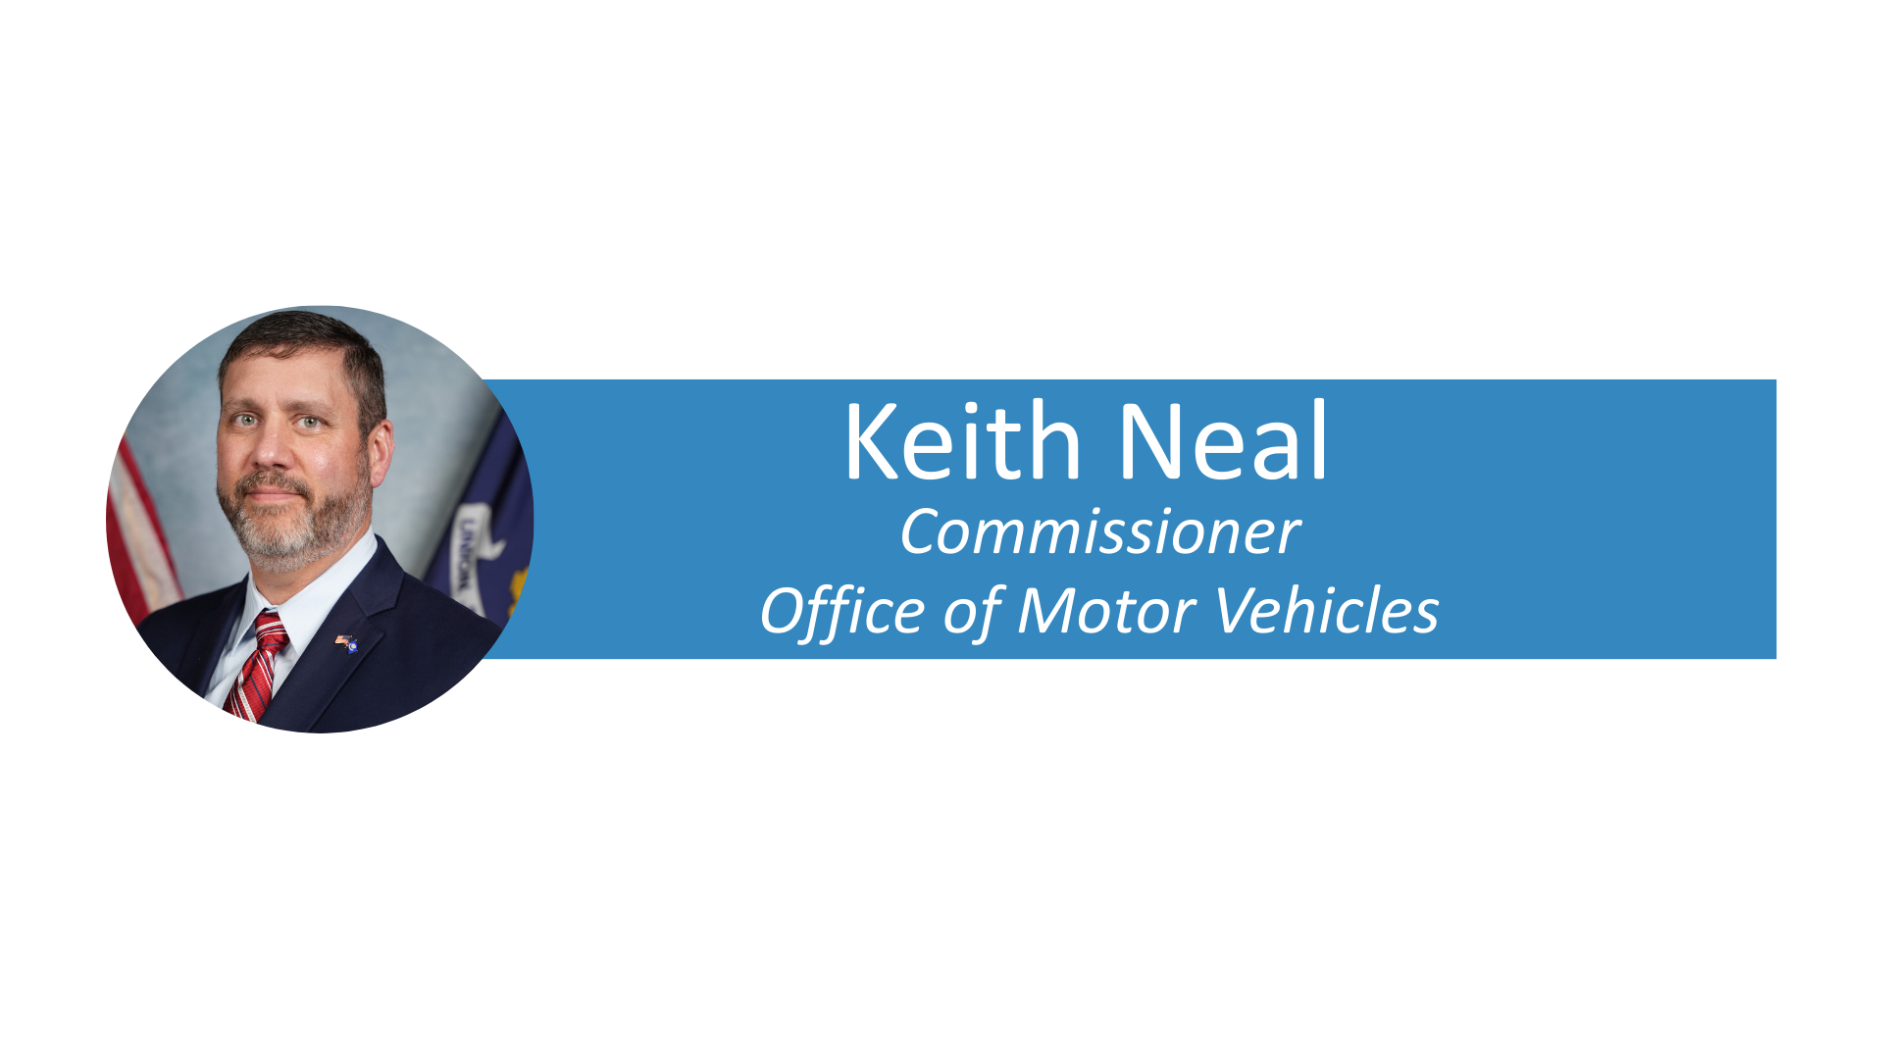


Slide 3
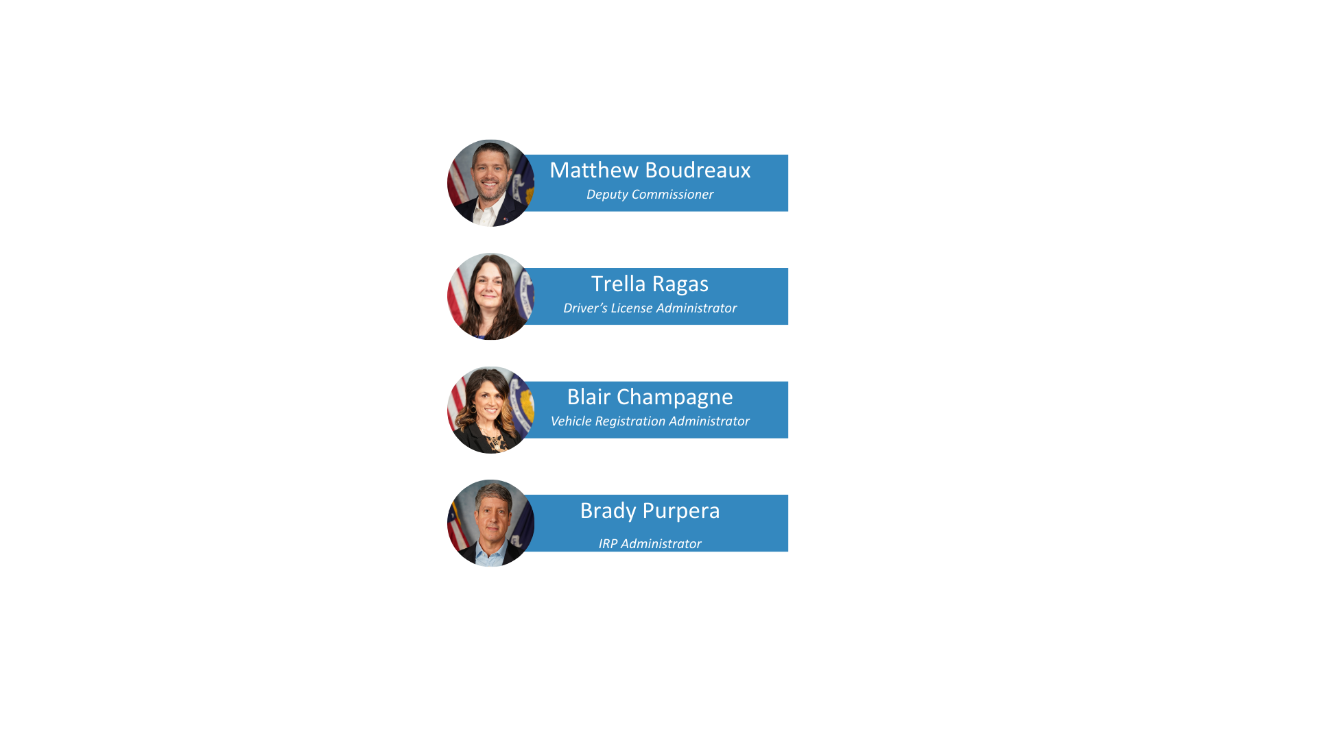

Slide 4
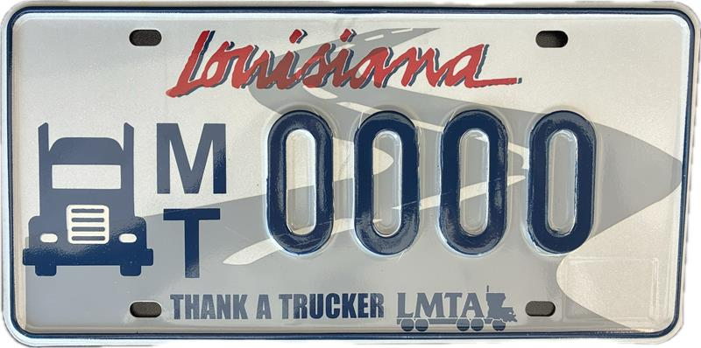
LMTA Specialty License Plate Information
As of Jan. 07, 2026, OMV has sold 51 LMTA specialty license plates.
Total royalty disbursement for the plate: $4,314.60

Slide 5
Louisiana Trucking Research and Education Council Surcharge

Slide 6
LA Wallet & OMV Push Notifications
  Enhancing Driver Medical Status Awareness
  LA Wallet and LA OMV will soon send push notifications through the LA Wallet app
  Notifications will inform drivers of important medical and commercial status updates
  Drivers will receive a push notification when the are going to be marked “Medically Not Certified” and when commercial status is cancelled
  Ensures timely awareness of medical status changes
  Helps drivers take prompt action if required

Slide 7
Drug and Alcohol Clearinghouse
Starting September 15, 2026
  LA OMV will electronical query the Clearinghouse
  Queries will occur before issuing, renewing, upgrading, or transferring a CDL or CLP
  Drug and Alcohol Violation will be added to a record electronically
  Will result in quicker appointments at OMV

Slide 8
Electronic Medical Certification Queries
  Starting September 15, 2026
  LA OMV will electronical query the National Medical Registry
  Paper DOT Medical Certificates will no longer be required
  Will result in quicker appointments at OMV

Slide 9
IRP Resources
Contact Information
(225)925-7022
irpdocuments@la.gov
Website
Expresslane.org
Driver’s license, vehicle title, registration and reinstatement information
Forms
LA-Trucks-Online.org
Louisiana IRP specific website
Up-to-date IRP notifications including emergency declaration
IRP office list including addresses and hours of operation
Forms

Slide 10
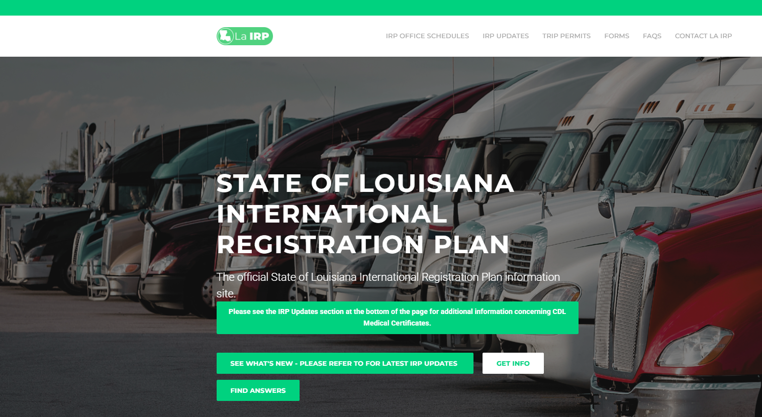
Resources on LA-Trucks-Online.Org

Slide 11
IRP Office Locations
Alexandria | 5602 Coliseum Blvd Alexandria, La 71303 | 8:00 AM – 4:00 PM Monday - Friday
Baton Rouge | 7701 Independence Blvd Baton Rouge, La 70806 | 8:00 AM – 4:00 PM Monday - Friday
Houma | 108 Capital Blvd Houma, La 70360 | 8:00 AM – 4:00 PM Monday - Friday
Lafayette | 3241 NW Evangeline Thruway Lafayette, La 70507 | 8:00 AM – 4:00 PM Monday - Friday
Lake Charles | 951 Main St. Lake Charles, La 70615 | 8:00 AM – 4:00 PM Monday - Friday
Mandeville | 1715 N Causeway Boulevard Mandeville, La 70471 | 8:00 AM – 4:00 PM Monday - Friday
Monroe | 5171 Northeast Rd Monroe, La 71203 | 8:00 AM – 4:00 PM Monday - Friday
Shreveport | 6005 Financial Plaza Shreveport, La 71129 | 8:00 AM – 4:00 PM Monday - Friday
All IRP office visits are by appointment.

Slide 12
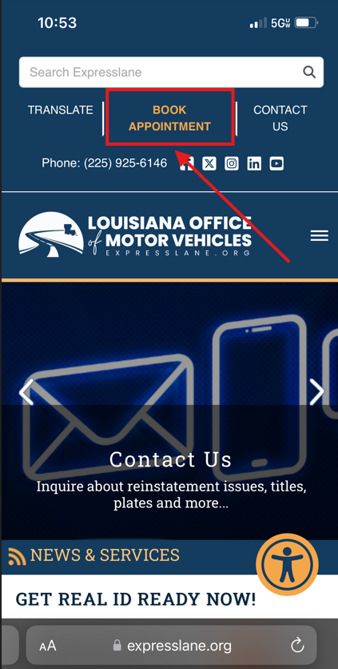
Appointments
Appointments must be scheduled for customers wishing to process IRP transactions in person.
Appointments must be scheduled through Expresslane.org.

Slide 13
Things to Note:
IRP renewal packets:
Will be mailed to the carrier 60 days prior to expiration
May be emailed, mailed or processed in an IRP office
Email: irpdocuments@la.gov - invoice will be emailed to sender
Mail: LA IRP Unit, P.O. Box 64848, Baton Rouge, LA 70896
In office – appointment required
Must be postmarked or emailed by the 15th of the month prior to the month of expiration to ensure the renewal is processed prior to the last day of the renewal period.
There is no grace period on renewals. A 5% penalty will be assessed monthly and will be calculated on the base registration fee.
All renewals and other supplements received are processed in the order received.

Slide 14
Louisiana Trucking Research and Education Council Fee
2022 - $441,510.00
2023 - $449,580.00
2024 - $450,195.00
2025 - $438,885.00

Slide 15
IRP Audits Performed
2022 Audits Finalized - 36
2023 Audits Finalized - 57
2024 Audits Finalized - 167
2025 Audits Finalized - 100

Slide 16
Louisiana UCR Fees Collected
FY 2022 - $1,263,698
FY 2023 - $923,397
FY 2024 - $806,264
* FY 2025 - $949,886
*2025 registration year will be collected until
September 30, 2026.
Louisiana UCR Entitlement Cap is $4,036,386

