Slide 1
OPERATIONS THAT HIT
THE BOTTOM LINE
DRIVE PROFITABILITY| DELIVER EXCELLENCE

Slide 2

About Me
Experience:
  I have more than 30 years of experience in the transportation and logistics industry with most years using different technology over those years. Throughout my career, I’ve worked across transportation operations, giving me a practical understanding of the challenges carriers face every day. In my current role as a Sr. Sales Solutions Consultant with McLeod Software, I work with customers and prospects to understand their operations and demonstrate how McLeod technology can help improve efficiency, visibility, and overall business performance.

Slide 3
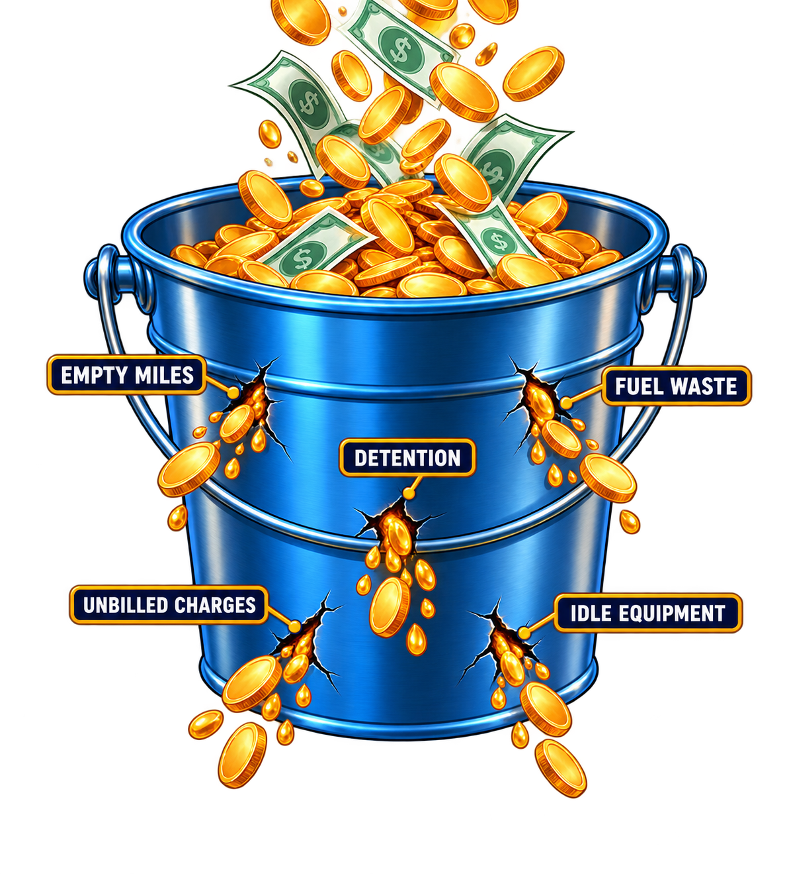
The Leaky Bucket
Your Company’s Bucket
Every load adds money to the business.
Little leaks, if not addressed, become big hits to the profit for your company at year end.

Slide 4
Which Operational Leak Hurts Most?
Operational Leak | What It Does Financially
Empty Miles / Deadhead | Adds fuel, labor and other trip costs
An Idle Truck | Carries fixed expense and misses contribution
An Unbilled Accessorial or Detention | Leaves eligible revenue unrecovered
Poor Asset Assignments | Reduces productive capacity and trip contribution

Slide 5
ATRI Benchmarks Show Little Room For Leakage
2026 report, covering 2025 operations
$2.336
$1.854
Average operating cost per mile
3.4% higher than the prior year
Cost per mile excluding fuel
4.2% higher than the prior year
Operating margins
Truckload and refrigerated: below 1%
Flatbed / oversize: −0.5% Tank: 4.0%
Source: ATRI 2026. Benchmarks vary by fleet, sector and duty cycle.

Slide 6
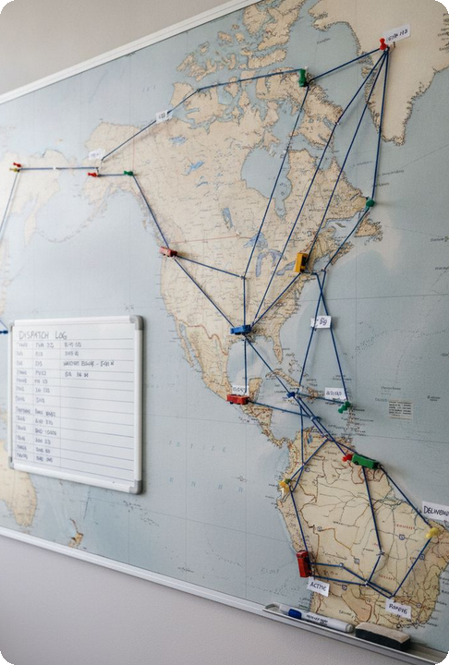
Planning Drives Profitability
Strong Planning Helps:
Reduce Empty Miles
Next-load location changes the cost of this load.
Customer Satisfaction/On-time Performance
A feasible trip protects the next revenue opportunity.
Increase Driver Productivity
A workable assignment supports service and retention.
A well-planned operation can often generate more profit without adding a single truck

Slide 7
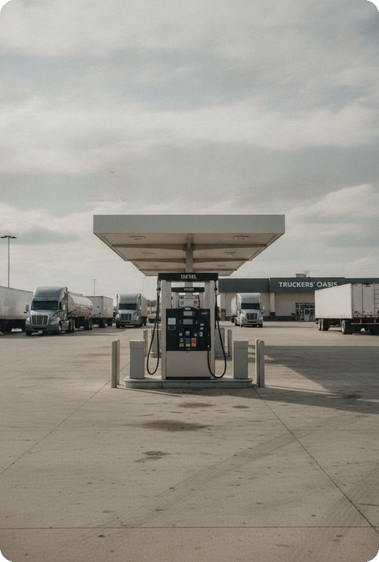
Fuel: The Largest Variable Expense
Effective Fuel Management Involves:
Route Optimization
Idle Time Reduction
Driver Coaching
Purchasing Fuel Strategically
Monitoring Fuel Efficiency by Truck and Driver
The goal is not simply buying cheaper fuel. It's creating a culture where fuel efficiency becomes part of everyday decision-making.

Slide 8
Even Half an MPG Can Have an Impact
Illustrative: 100 tractors, 100,000 miles each, 6.5 MPG improving to 7.0
109,890
Fewer gallons annually
7.14%
Reduction in fuel used
Miles × (1 / old MPG − 1 / new MPG) × price per gallon. Gross savings before program cost and surcharge effects.

Slide 9
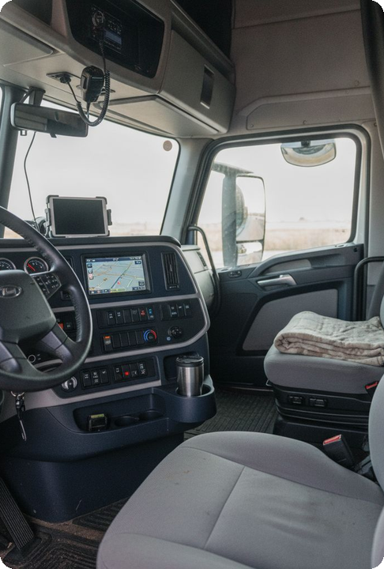
Labor: Maximizing Productivity
Today's challenge isn't simply finding labor. It's maximizing the productivity of the labor you already have.
Questions every operation should ask:
Are dispatchers spending time on high-value activities?
Are drivers maximizing available drive time?
Are repetitive tasks automated where possible?
Are employees working with timely and accurate information?
Risk of Cutting Pay
Optimize Work Design
Lower wages can raise vacancies and trigger costly turnover.
Focus on reliable miles and home-time to support retention.

Slide 10
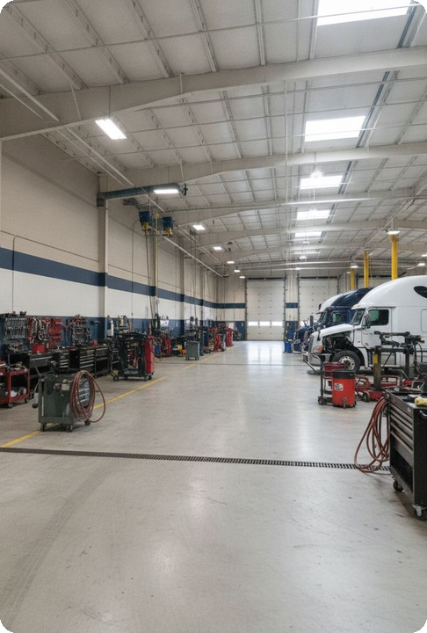




Equipment Utilization
Owned Trucks
Available Trucks
All units in the fleet, whether active, idle, or under repair.
Ready for use but not assigned to a driver or load.
Seated Trucks
Dispatched Trucks
Assigned to a qualified driver, not necessarily dispatched.
On an active load assignment, generating revenue miles.

Slide 11
Equipment Utilization
Equipment Utilization is one of the clearest indicators of operational health
These key metrics provide a better understanding of your EU:
Revenue per truck
Loaded versus empty miles
Trailer utilization
Dwell Time
Asset turnaround time
The question should always be:
How do we get more productivity from the assets we already own?

Slide 12
Equipment Utilization Changes Fixed Cost Per Truck
Illustrative annual fixed equipment expense: $60,000 per truck
20%
Lower fixed cost allocation
per mile
$60,000
Annual fixed expense
Better cost absorption creates value when the added freight earns contribution.

Slide 13
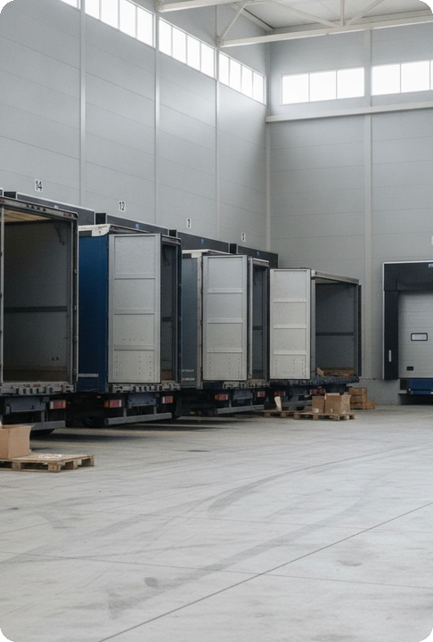
Day-to-Day Operational Execution
Daily exceptions create different financial effects
Operational Exception | Financial Effect to Trace
Load Acceptance / Driver Assignments | Lost revenue, increased deadhead, lower driver/equipment utilization, higher labor, and potential service penalties.
Detention / Appointment Scheduling | Paid waiting and lost next-load contribution
Equipment Maintenance | Repair expense and unavailable capacity
Missing PODs / unbilled charges | Billing delay or unrecovered eligible revenue
Invoice disputes | Delayed cash, concessions or write-offs

Slide 14
Accessorial Recovery at Each Stage
Illustrative cohort, measured at the same date
$20K documentation gap
Eligibility needs supporting proof.
$10K billing gap
Supported charges await invoicing.
$15K uncollected
Timing, dispute or potential loss.
A gap is a control signal. Collection timing and permanent revenue loss are different.

Slide 15
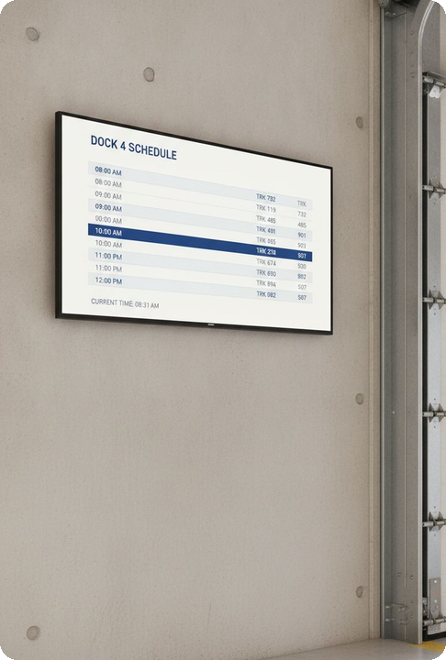
The Power of Visibility
You cannot improve what you cannot measure
Successful carriers use data and technology to answer critical questions:
Where are our costs increasing?
Which lanes are most profitable
Which customers create the strongest margins?
How productive is each asset?
Where are we wasting time and resources?

Slide 16
Finance-Operations Routine & Scorecard
1
2
3
Empty Miles / Total Miles
Gallons & Net Fuel $ / Mile
Unseated Tractor‑Days & Early Retention
Planning owner. Drives loaded-mile contribution and identifies avoidable cost per trip cycle.
Fleet/fuel owner. Tracks fuel economy and purchase cost per total mile, quantifies net savings or exposure.
HR/ops owner. Monitors lost capacity and early driver turnover, flags avoidable expense and missed revenue.
4
5
Available Truck‑Days & Contribution/Day
Eligible‑to‑Billed Accessorial $ & Delivery‑to‑Invoice Hours
Maintenance/ops owner. Measures productive equipment days and contribution per available day.
Billing/ops owner. Reveals billing leakage and delivery-to-cash lag impacts on cash flow.
1
2
3
4
Reconcile Systems & Ledger
Separate Price/Volume/Mix/Execution
Count Unseated Assets
Review Leakage & Actions
Align operational KPIs with financial records to ensure accuracy.
Clarify drivers of period changes and prevent denominator hiding.
Include inactive equipment in capacity reviews for full accountability.
Rank gaps by dollars and controllability. Assign joint owners per opportunity.
Which recurring operating decision would you change next Monday, who owns it, and which financial result would prove it worked?

Slide 17
Closing Thoughts
Daily operating decisions shape the bottom line
Small leaks add up
Empty miles, excess fuel use and missed accessorials reduce the value of every load.
Existing capacity deserves attention
Better planning and asset utilization can improve productivity without adding trucks.
Visibility needs an owner
Connect operating measures to financial results and assign responsibility for the gaps.
NEXT MONDAY
Choose one controllable leak. Name an owner and a financial measure of success.
Notes:
Closing recap of the existing presentation.
[Sources]
Small leaks: slides 3, 6, 7 and 14.
Existing capacity: slides 6, 9, 11 and 12.
Visibility, accountability and next Monday action: slides 15 and 16.
[/Sources]

